Slide 1
Revenue Diversification in Africa through bio-based and circular Agricultural Innovations
NUST

Slide 2
Contents
Introduction to DivAgri.
Self-regulating, Low Energy, Clay-based Irrigation SLECI
Multi-functional constructed wetlands (MFCW)
Biorefinery and Ethnobotanical intercropping
Biogas digestor
TLUD Biochar kiln
Solar desalination greenhouse (SDG)
Mobile integrated biorefineries for conversion of farming residues to high-value chemicals
NUST

Slide 3
Introduction
Revenue Diversification Pathways through bio-based sustainable agricultural innovations Project (DIVAGRI) is a 4-year project funded by the European Union.
The project offers a variety of innovative solutions tailored to assist ecosystem restoration; enhance crop production through regenerative agricultural systems; and convert biomass into high-value bioenergy.
These technologies are developed and adapted to the needs of the local end-users such as farmers, tourism establishments and schools.
NUST

Slide 4
Introduction…..cont..
DIVAGRI technologies are also an adaptation mechanism against climate change impacts. Development of technologies is influenced by indigenous knowledge infused with modern methods to enable local adaptation.
The use of bio-based technologies further promote the circular economy concept by providing sustainable solutions for the production, transformation and use of biological resources.
Of-course investment is necessary to be able to increase income and to diversify technologies by farmers and establishments that are considering the technologies.
DIVAGRI supports community participation and co-development of collaborative business models; increase income and generate new economic opportunities while guaranteeing food security, real rural opportunities, and sustainability.
NUST

Slide 5
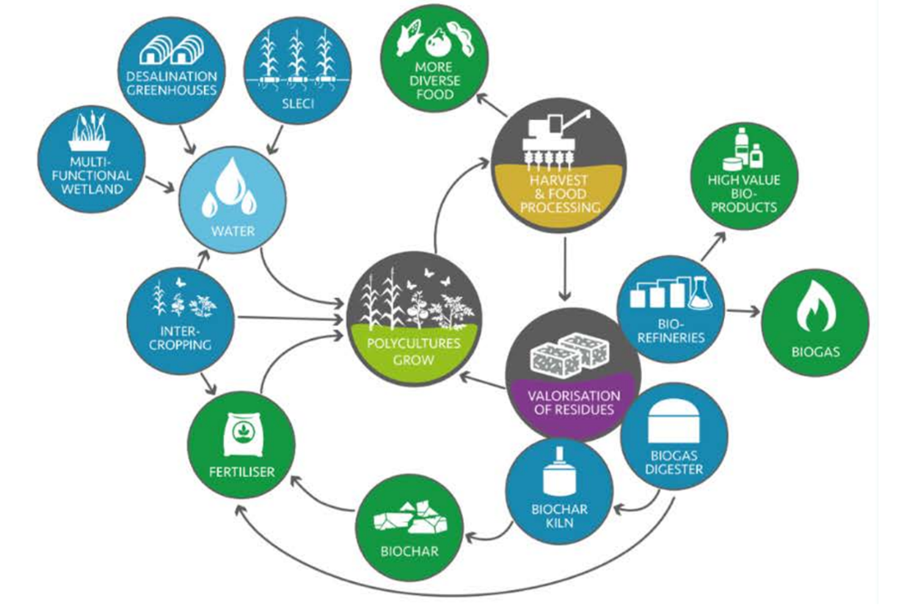
Circular economy that DIVAGRI technologies are promoting
NUST

Slide 6
Figure 1: DivAgri revenue generation strategies
DIVAGRI aims to provide farmers with affordable access to high quality farming inputs, resulting in increased and diversified source of income and more sustainable practices.
NUST

Slide 7
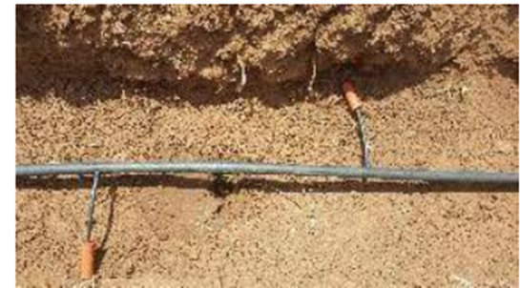
Self-regulating, Low Energy, Clay-based Irrigation (SLECI)
Optimize performance in agroforestry systems, in a variety of soil types with low-grade irrigation water.
This technique combines nature-based wastewater reclamation techniques which reduce the amount of irrigation water needed from dams, boreholes, lakes and rivers by at least 70%, and reduce the amount of energy used for water pumping by 90%.
Figure 1: SLECI pipes and clay tubes
NUST

Slide 8
In SLECI, water is transported via clay tubes which have a higher suction tension than the applied hydraulic pressure, so the surface of the clay tubes stays damp.
DIVAGRI will investigate its performance in a variety of local conditions and in combination with various (reclaimed) irrigation waters.
Only about 6% of Africa’s cultivated land is currently under irrigation (compared to 30% in Asia). By applying SLECI, it will enable smallholder farmers to irrigate crop fields including feed crops, which will enable them to produce higher food crop yields and cover livestock feed requirements during dry seasons.
NUST

Slide 9
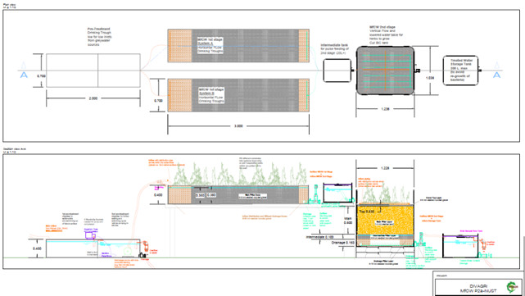
MultiFunctional Constructed Wetland (MFCW)
DIVAGRI provides productive constructed wetlands, natural wastewater treatment solutions, to produce both biomass and reclaimed irrigation water.
This combines wastewater treatment and direct reuse in low-input production systems for crops.
Wastewater is pre-treated with cultivation of industrial and energy crops in stage 1, and edible crops growing in the effluent in stage 2, with both converging and root zones separated systems piloted.
NUST

Slide 10
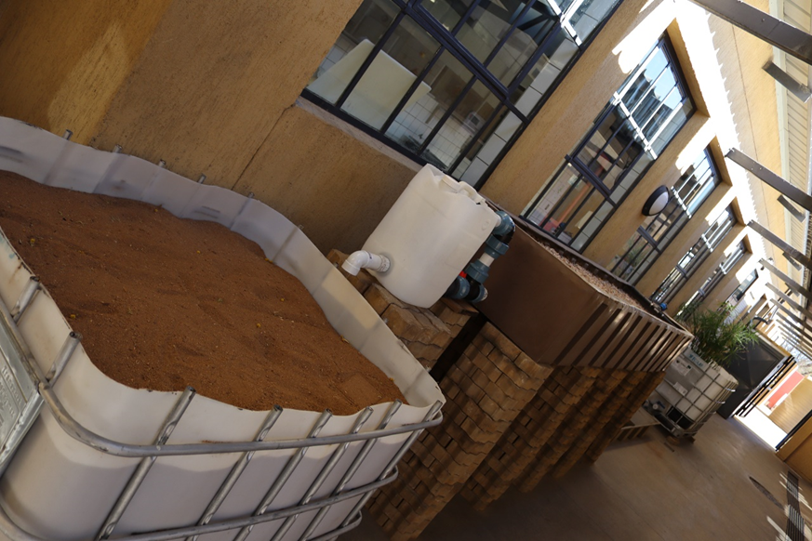
MFCW at NUST
1st Pre-Treatment: Chamber to settle solids and swimming up of fats to surface
2nd Pre-Treatment: Chamber for further settling and swimming as well as pumping to MfCWs
NUST

Slide 11
Ethnobotanical intercropping and regenerative farming technique
DIVAGRI is exploring new combinations of trees and food crops learning from traditional successful intercropping (mixed crops) practices.
Intercropping enables optimal utilization of resources (water, nutrients) while reducing soil erosion; and enhances crop yields.
The objective is to explore which of the crops with waste valorization potential can be enhanced or facilitated by growing them in combination with other crops that can be sold (e.g. higher value food such as strawberries that combine well in between rows of crops with low water requirements).
Existing successful agroforestry and intercropping systems (e.g. fruit forests, wheat with other summer crops, grains-legumes intercropping) are integrated with bioengineering techniques, reclaimed water, biochar and digestate use.
NUST

Slide 12
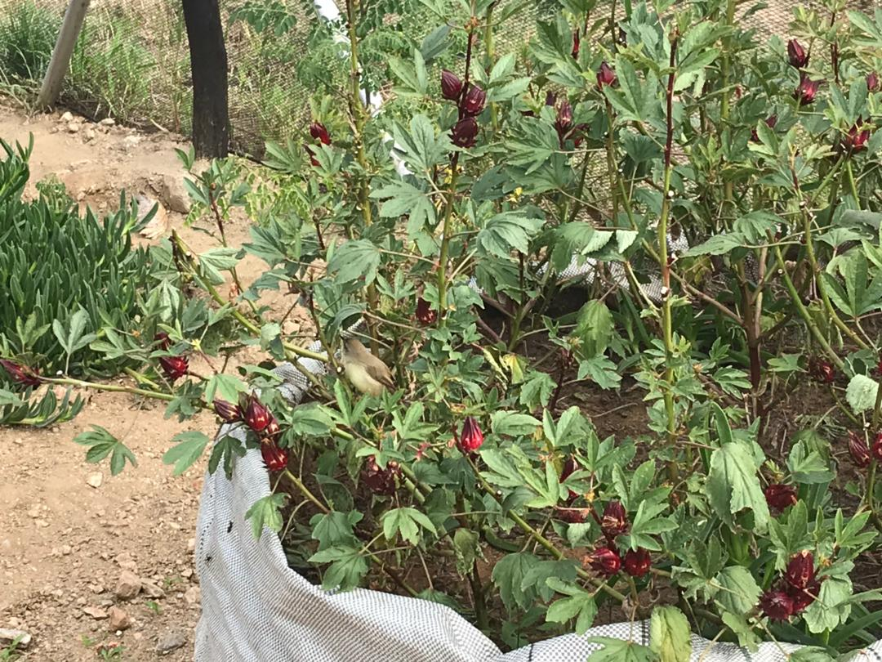
Ethnobotanical and intercropping at NUST
Nine hundred and seventy-five (975) garlic buds were planted, of which 875 were planted in the Nethouse, and 100 at the Hotel school kitchen. 15 of these garlic buds failed to shoot.
The crop seems to grow well especially in the 100 bags compared to the garlic intercropped with Moringa plots.
The garlic intercropped with vygies is not growing well compared to those that are growing on their own, although, all plots were mulched with the same materials such as mutete residues and with the same amount of water.
Figure 5: Red Mutete in the Nethouse NUST Hotel school
Figure 4: Nethouse garlic at NUST Hotel school.
NUST

Slide 13
Biogas digestor
A low-cost single-stage solar-supported biogas digester constructed with local materials and expertise.
The digester processes final residues of the biorefinery extractions together with other biodegradable wastes (livestock manure, crop residues, sewage sludge).
The biogas digester has an inlet valve in which other digestible wastes can be introduced for co-digestion.
A solar panel affixed to it heats the system with the rationale of killing all pathogens in the wastes while maintaining methane-producing bacteria for biogas and methane production.
The hygienized digestate will be used as fertilizer for vegetable crops.
The biogas can supply cooking gas for farmers or a larger scale unit (community managed model) can be connected to a combined heat and power (CHP) generator to produce electricity.
NUST

Slide 14
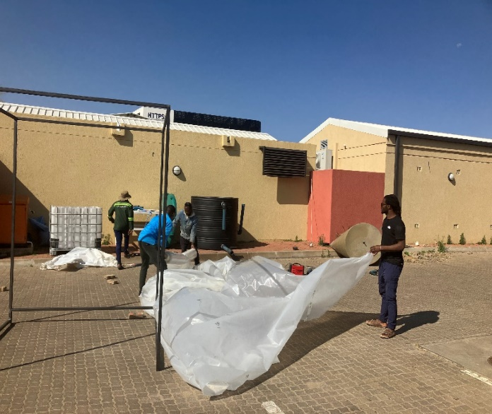
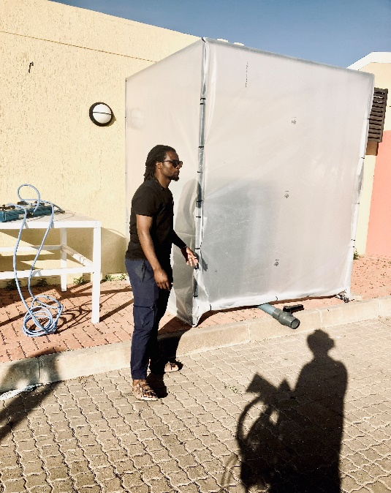
Biogas digestor at NUST
Kitchen waste from the Hotel School kitchen woulb be used for feeding the digestor. When feeding the biogas, the kitchen wastes need to be liquified.
Kitchen wastes can be introduced at least two weeks after introducing wet manure in the biogas.
Figure 6: Biogas construction at NUST pilot site
Figure 7: Completed biogas covered in a greenhouse
NUST

Slide 15
BioChar Kiln
A Top Lit Updraft (TLUD) kiln for biochar production will be designed and optimized, working with different environments and feedstocks.
NUST will develop a low-cost, manually operated mobile biochar kiln, which can be constructed using only local materials, skills and equipment.
The DIVAGRI TLUD incorporates secondary waste heat recovery and utilization for communal purposes, such as hot water and cooking.
The main purpose of the system allows for biochar production on small-scale SME level, which can be collected and sold for additional income.
NUST

Slide 16
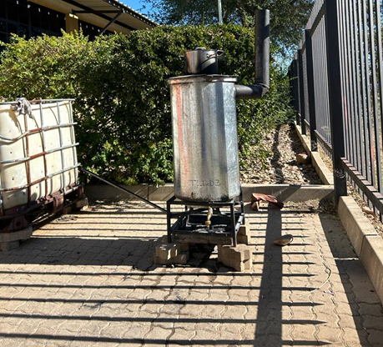
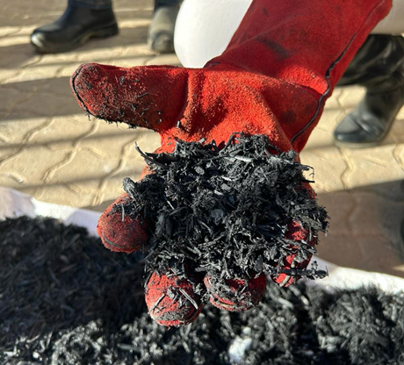
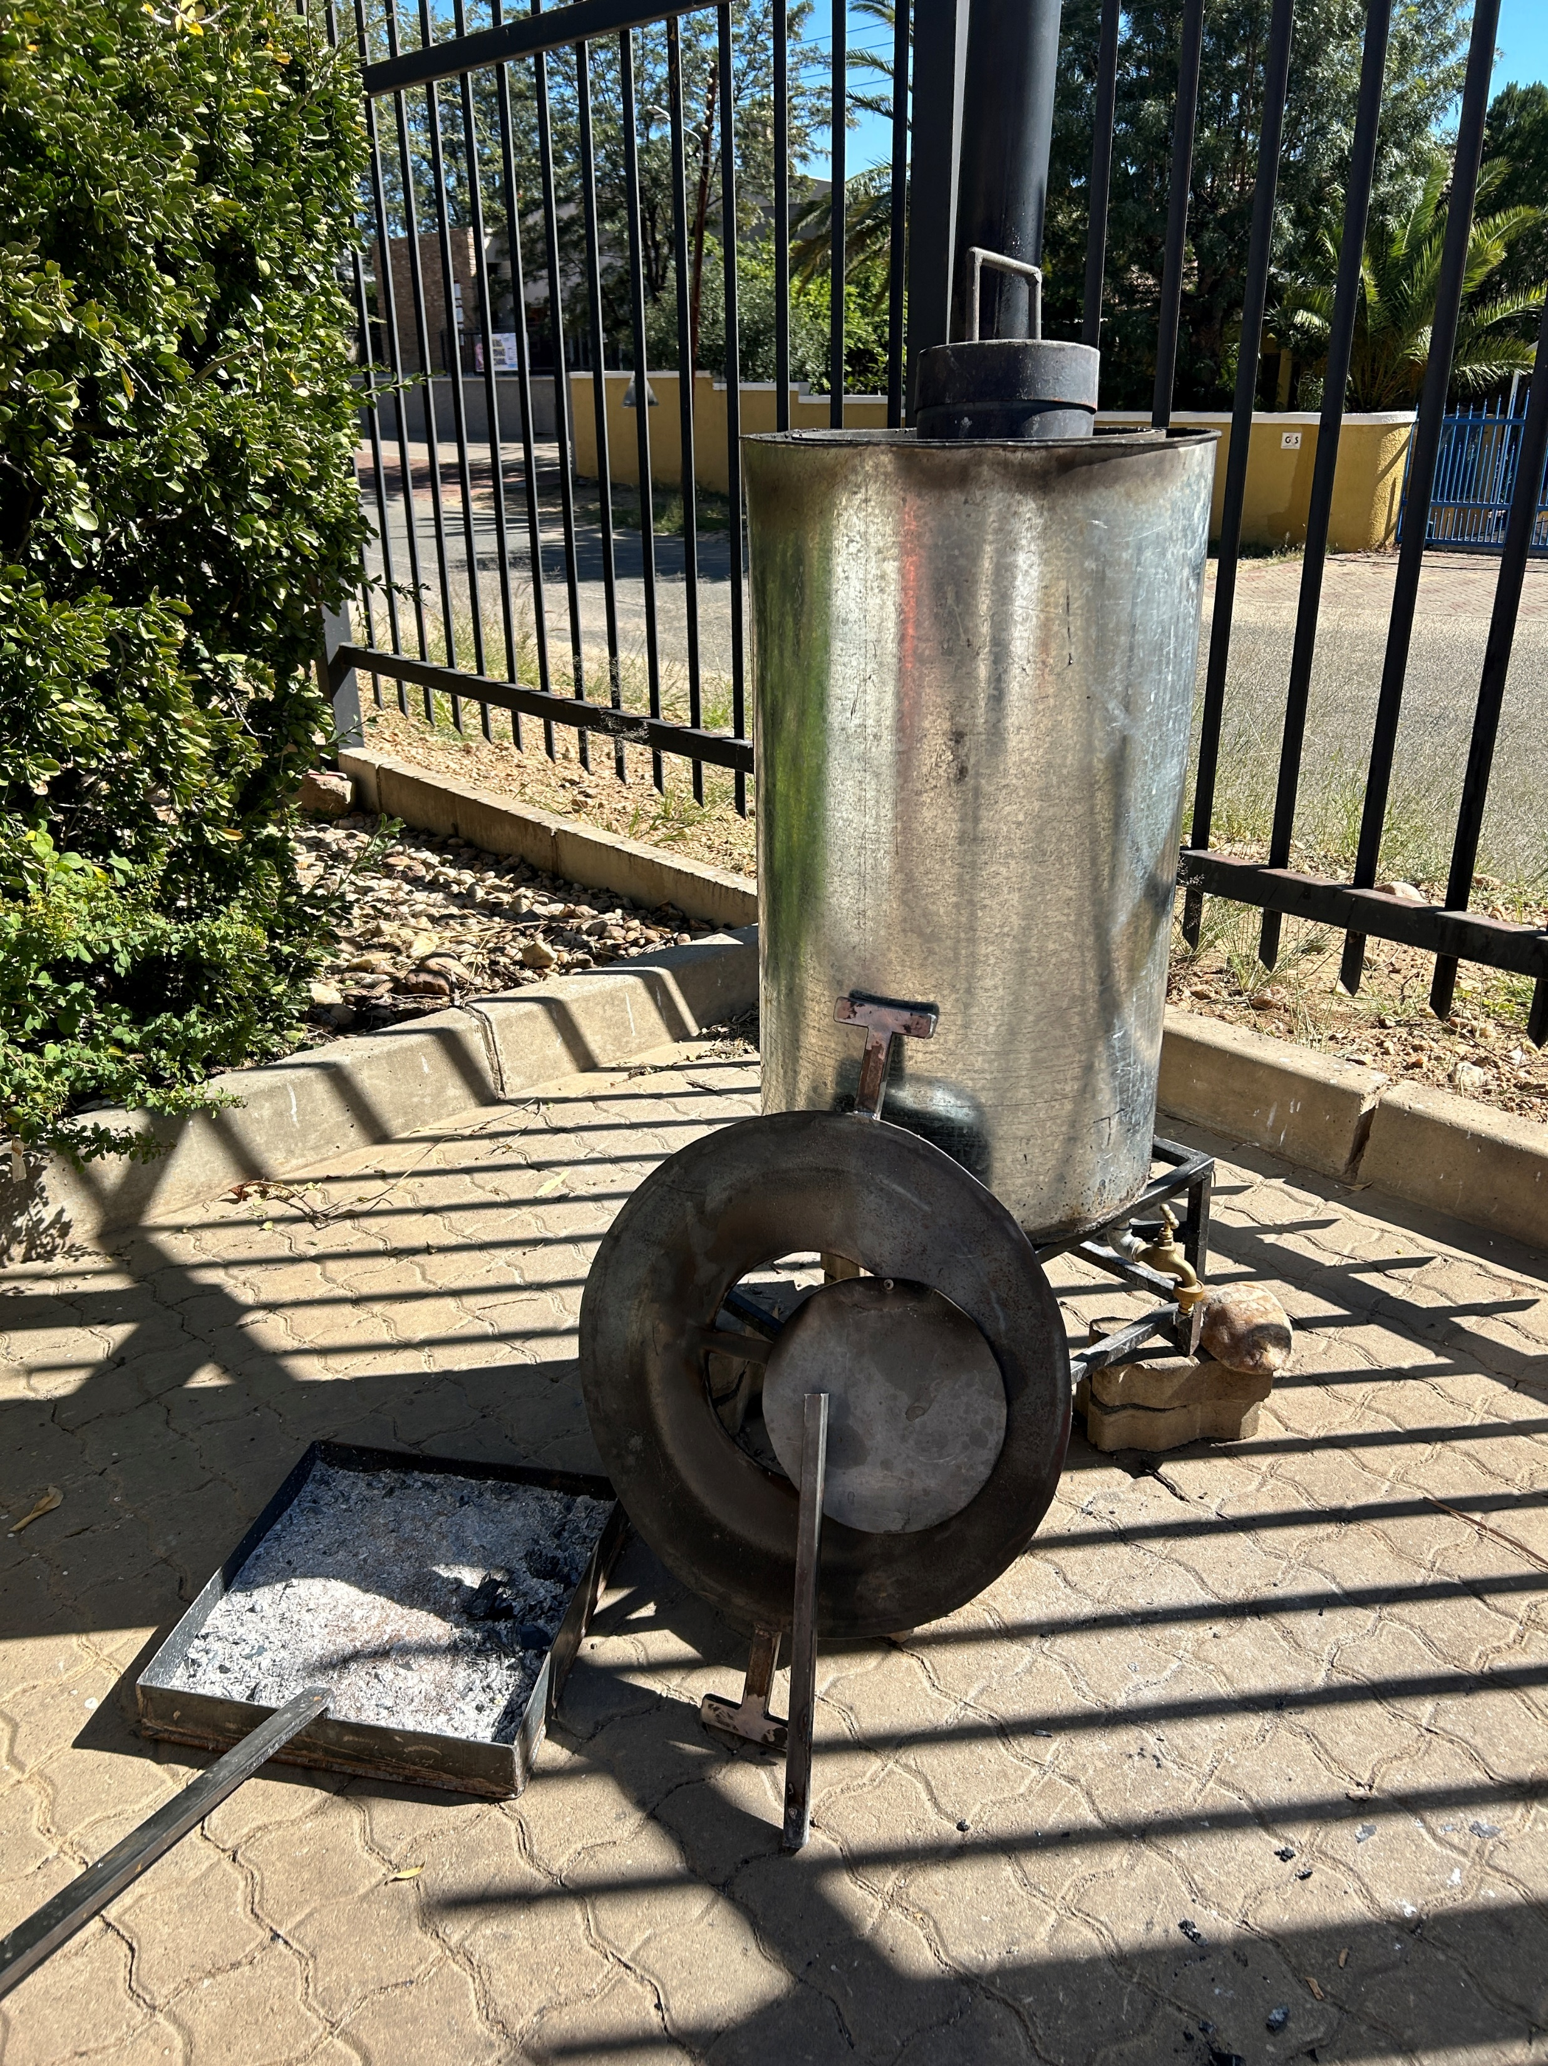
BioChar production at NUST
The biochar produced used; wood chips that weigh 2.0 kg, Weight of wood used for cooking both meat and rice 6.6 kg.
The experiment started at 14:30 to 15:20, so the total burning was 50min.
Biochar produced was weighed 1.02 kg.
NUST

Slide 17
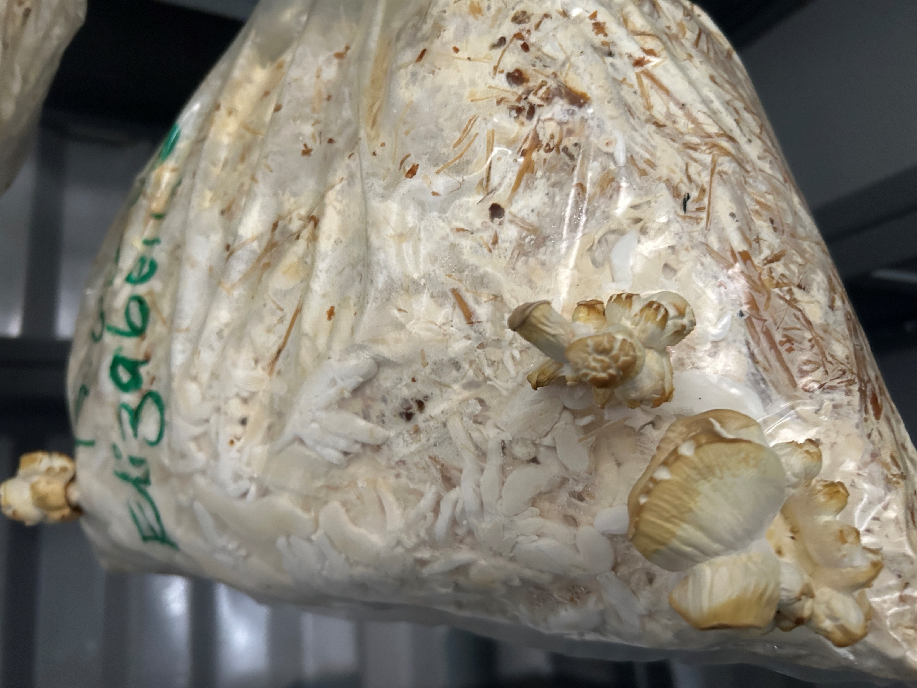
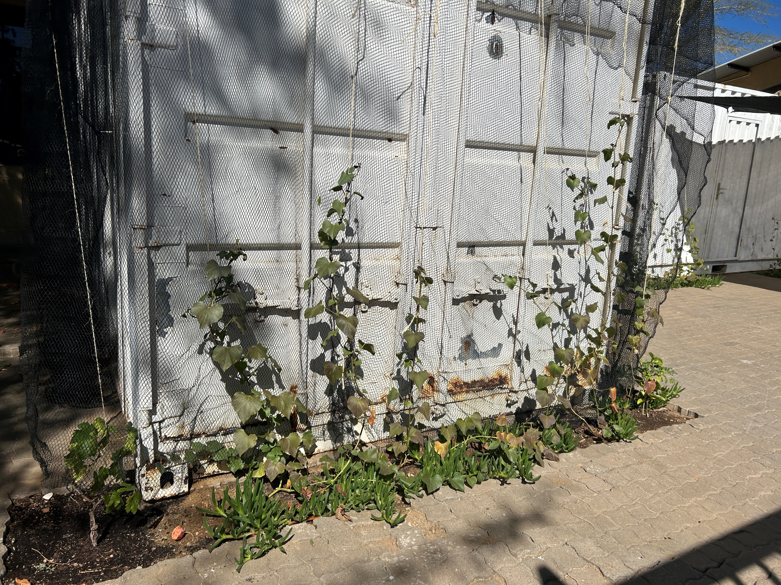
Mobile integrated biorefineries for conversion of farming residues to high-value chemicals
DIVAGRI’s decentralized mobile integrated biorefineries consists of biomass processing (e.g. shredding) and extraction units (e.g. water or ethanol extraction) fit to the size of the particular field.
Bio-based materials and components (e.g. pots of burnt clay) will be used to assemble the biorefineries.
The unit is constructed as a combination of sub-units, so that input feed can vary, and the output can be adapted to the needs of the user.
NUST

Slide 18
The sub-units are adopted to a set of steps…
Mechanical processing (shredding),
Separation of the shredded material into fractions for various tests (phenols, essential oils, etc.)
Extraction of different components (polyphenols, colorants or antioxidants).
Distillation
Fermentation (lactic acid fermentation, alcoholic fermentation or acetic acid fermentation).
The number of sub-units are evaluated against energy inputs versus easy to further processing.
The unit can extract high-value chemicals including colorants, fragrances and antioxidants.
The residues of the extraction and conversion processes can be used for feed as well as biochar and/or biogas production, which can also be designed as part of the system.
The carbon-depleted residues and lignocellulosic residues are returned to the fields as a rich nutrient source.
NUST

Slide 19
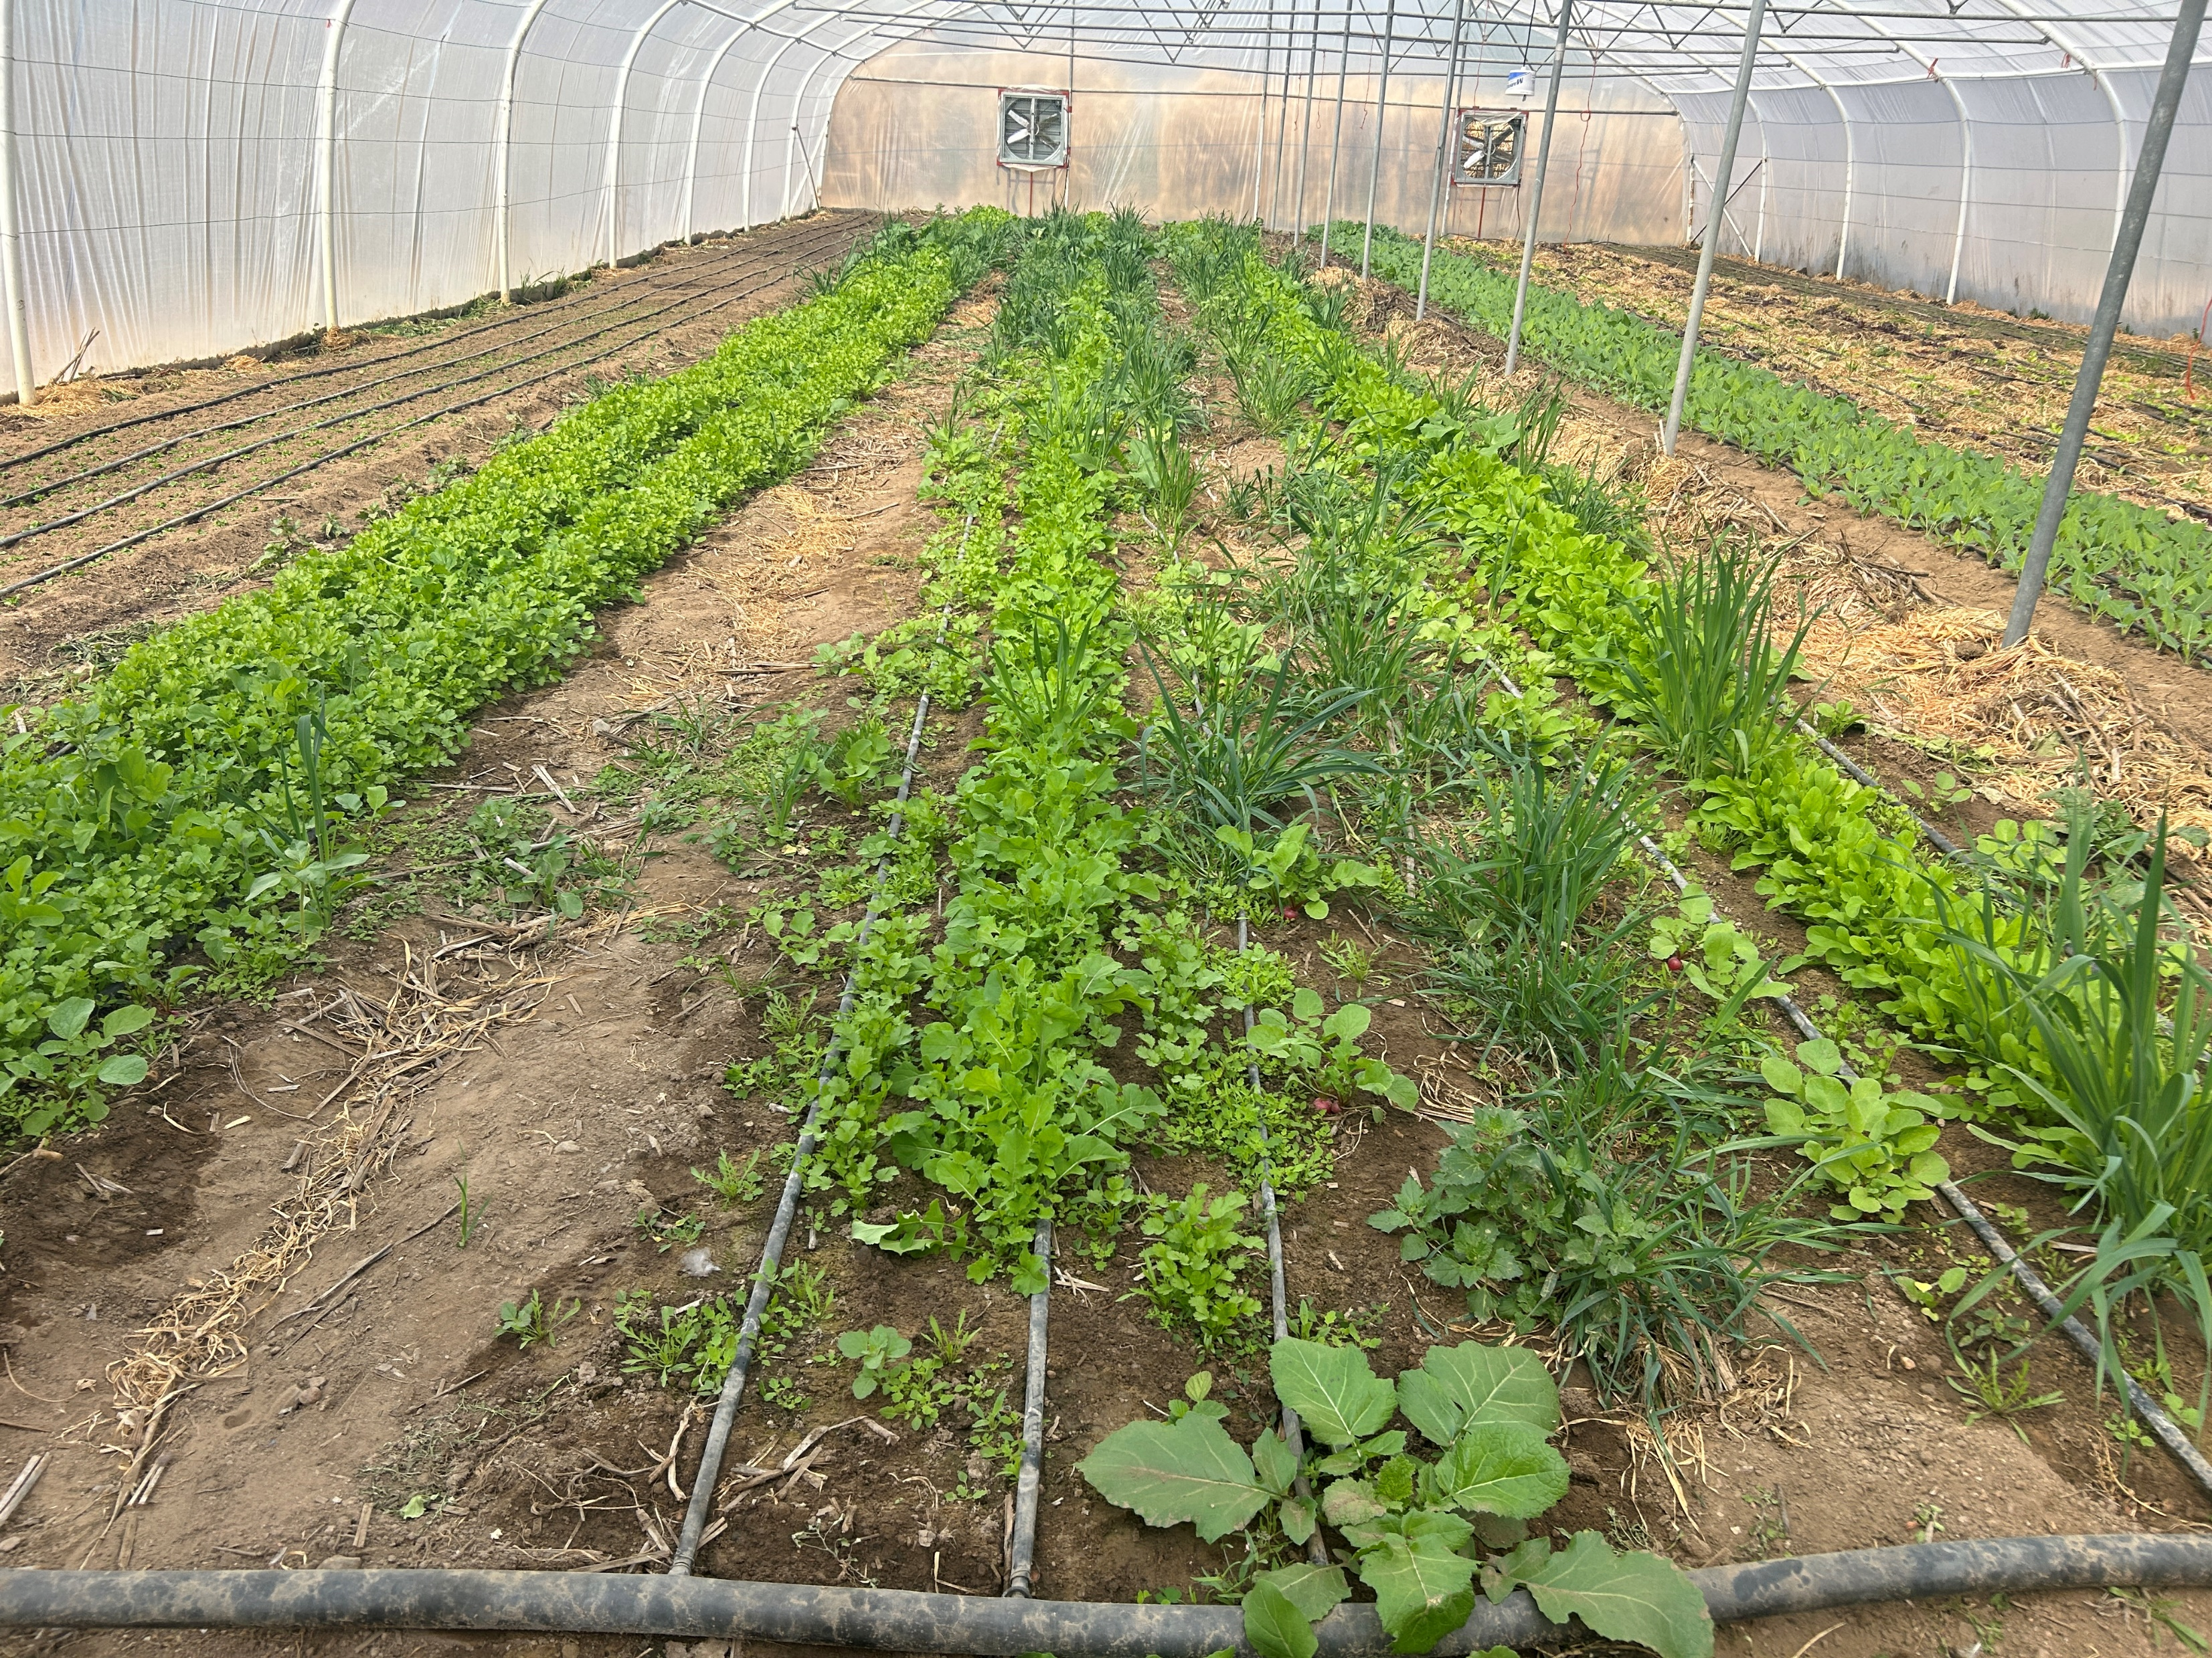
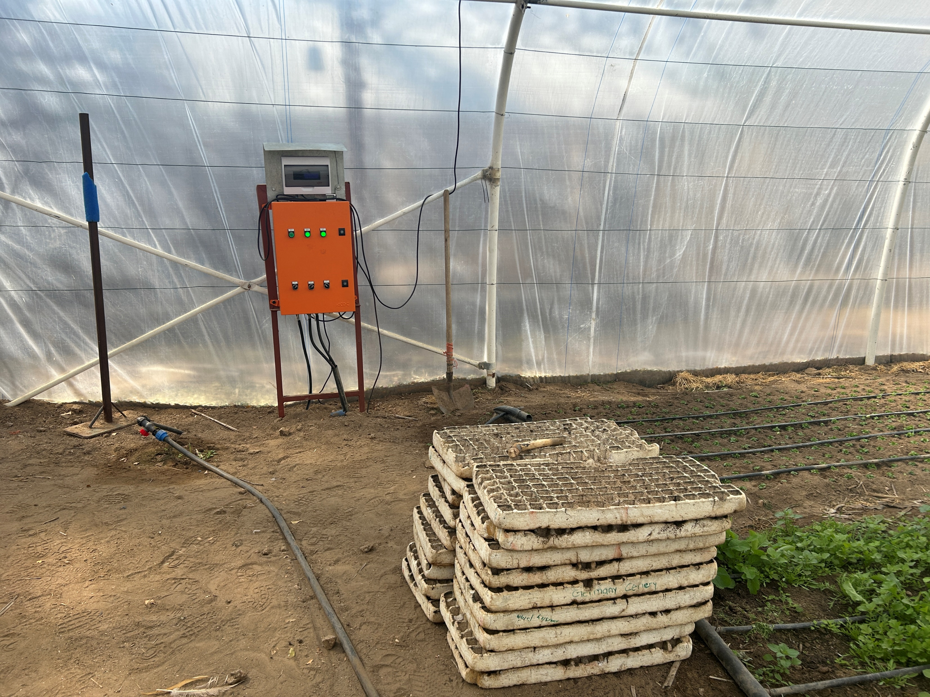
Solar desalination greenhouse for utilization of saline and low-grade water
Evaporation greenhouses are designed based on the principle of solar desalination stills where saltwater is evaporated through open surfaces, and the evaporation is increased by cultivating halophytic (salt-tolerant) plants in the desalination (evaporation) greenhouse.
An existing conventional greenhouse is retrofitted with a desalination compartment (DIVAGRI ‘retrofit kit’) or a stand alone structure is designed.
NUST

Slide 20
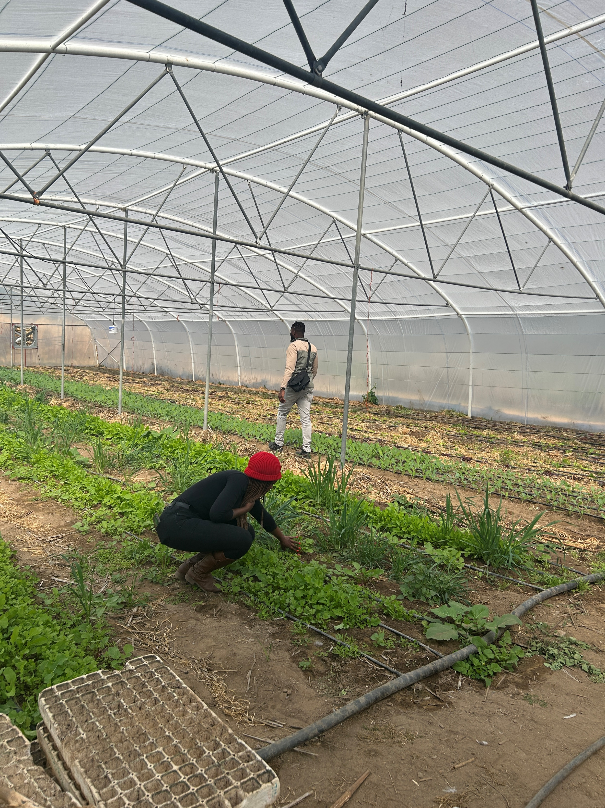
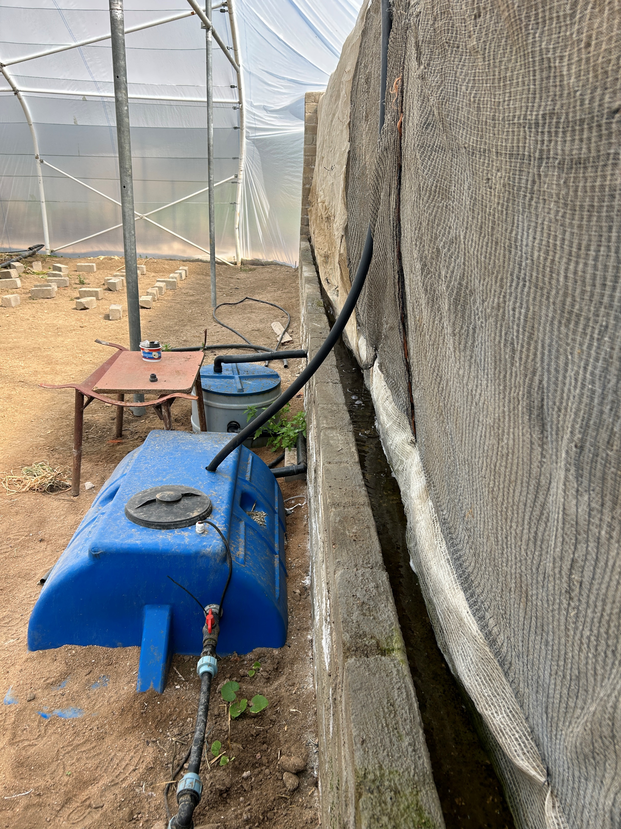
DIVAGRI tests passive surface cooling mechanisms to condensate the evaporated water (e.g. saline groundwater or seawater), roof cooling mechanisms such as materials, greening of roofs (xerophytes) and shaded/underground area.
cooling and humidification creates optimal growing conditions inside the greenhouse, which could reduce water losses from evapotranspiration by 90% and increase yields by 10-30%.
NUST

Slide 21
NUST

