Slide 1
Hunting as a green investment
Dr Simon Chiutsi
Namibia University of Science and Technology (NUST)
Hospitality & Tourism Dept
27 September 2023

Slide 2
The Context
Green investments-sustainable practices and investments that aim to reduce greenhouse gas emissions, conserve natural resources, and promote renewable energy sources.
Focuses on transitioning to a low-carbon economy and implementing green technologies and solutions.
Investments made in renewable energy, energy efficiency, sustainable agriculture, and other environmentally friendly industries.
In Namibia- hunting is a vital part of conservation and contributes to the economic sustainability of private game farms & communal conservancies

Slide 3
The Big Question?
Is hunting green investment?
Where does hunting fit in the green economy matrix?

Slide 4
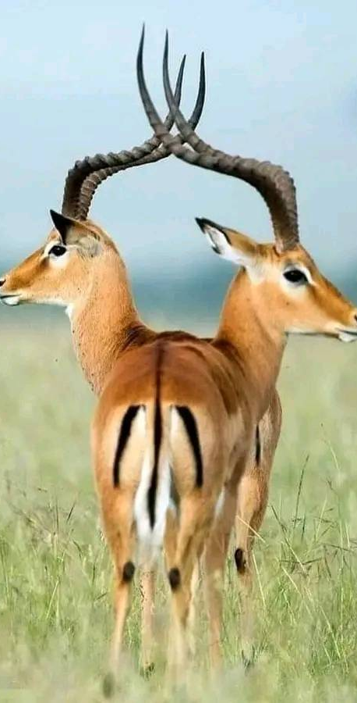
Problematic framing of the hunting industry
Debates on hunting tourism tend to follow ethical and ideological battle lines (Global South vs Global North)
Animal rights movement (consumptive/non-consumptive)
Potential biodiversity loss/negative ecological impacts
Opinions on environmental benefits are divided
Fragmented narratives by stakeholders
Contrasting visions and objectives for the planet & people
Resulting in difficulties to connect with global markets

Slide 5
Potential contribution of hunting tourism to green economy
Regulated hunting practices support conservation efforts and ensure the sustainability of wildlife populations
Hunting permits and fees generate revenue that can be used for wildlife conservation and habitat management
When hunting is regulated and sustainable, it can help control populations of certain species
Issues of HWC-tourism sector that addresses people and planet issues
Mitigating the environmental impacts of tourism, empowering communities, promoting their cultures, and contributing to essential social protection systems.

Slide 6
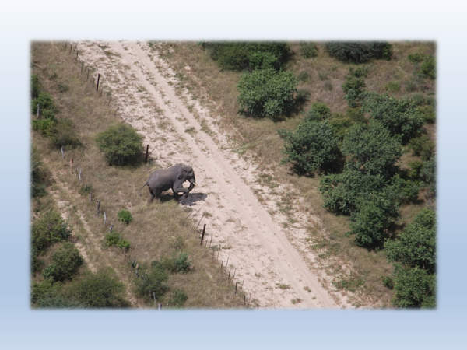
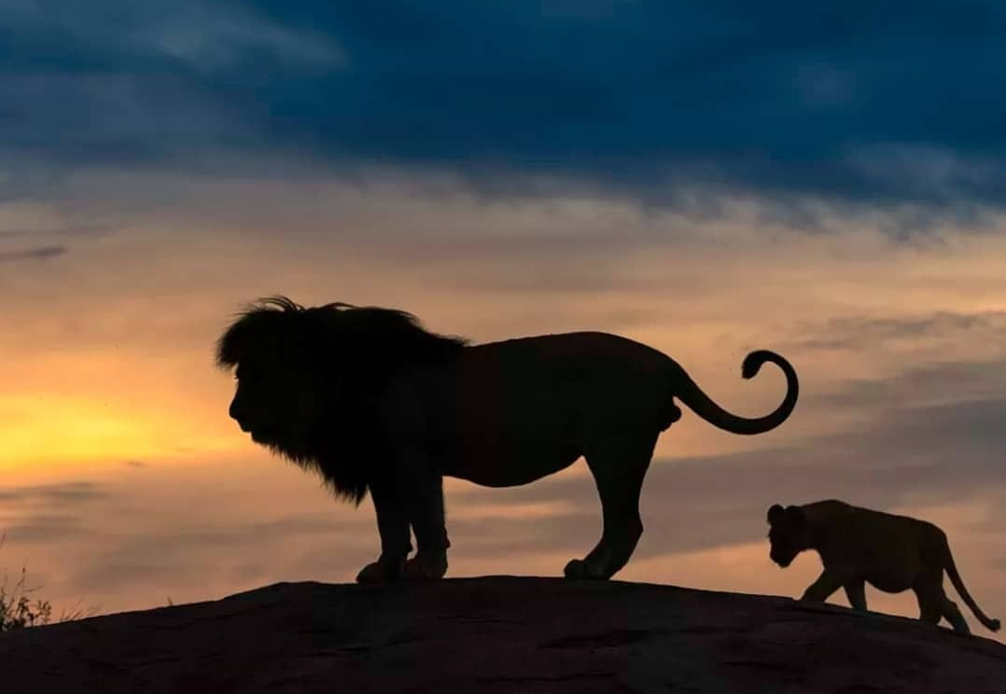
Local community concerns
Human wildlife conflict is on the increase (this is also the case in Namibia & Botswana)
Ineffective problem animal control causing a real danger to livestock and people
Secretive nature of the hunting industry-closed sector
Balancing the interests of the stakeholders-marginal communities continuously sidelined
Criminalizing hunting and other related wildlife resource utilization
Local communities cannot play an important role in biodiversity conservation without getting direct benefits from the conservation initiatives

Slide 7
Recommendations
Amplify community voices on hunting and conservation
Research and evidence-based narratives in the international community on contextual sustainability
Regional coordination and harmonization of policies and laws (Shoot to kill policies in some countries in SADC)

Slide 8
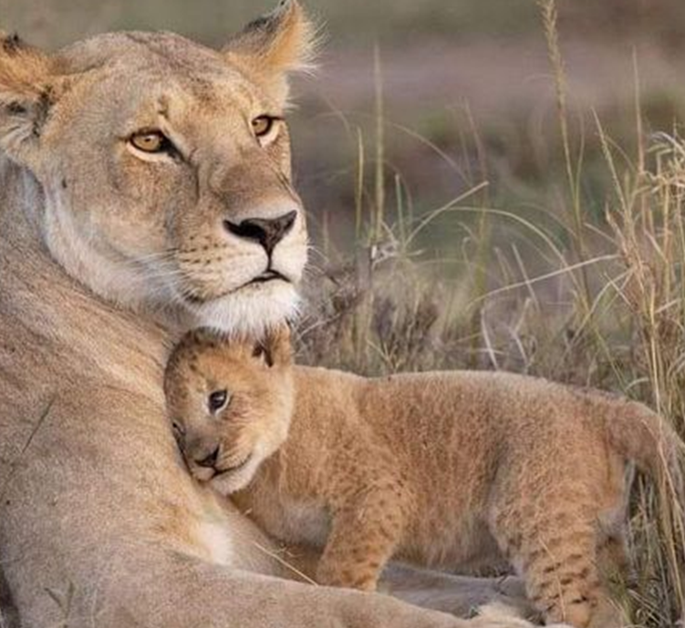
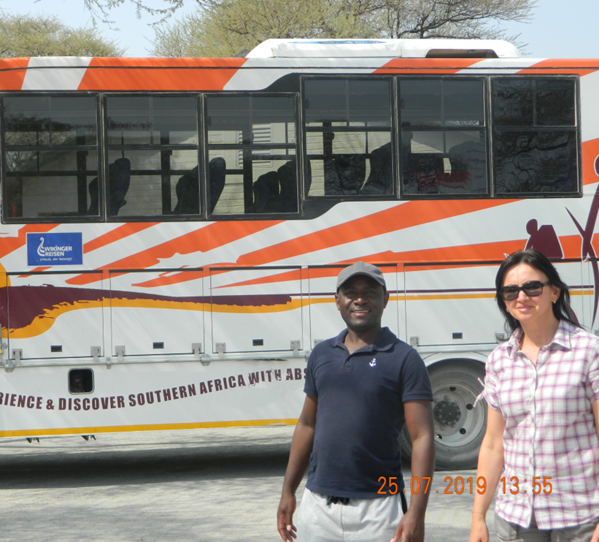
THANK YOU

