Slide 1
Wildlife Credits as a Payments for Ecosystem Services in Namibia – An introduction
A CBNRM initiative

Slide 2
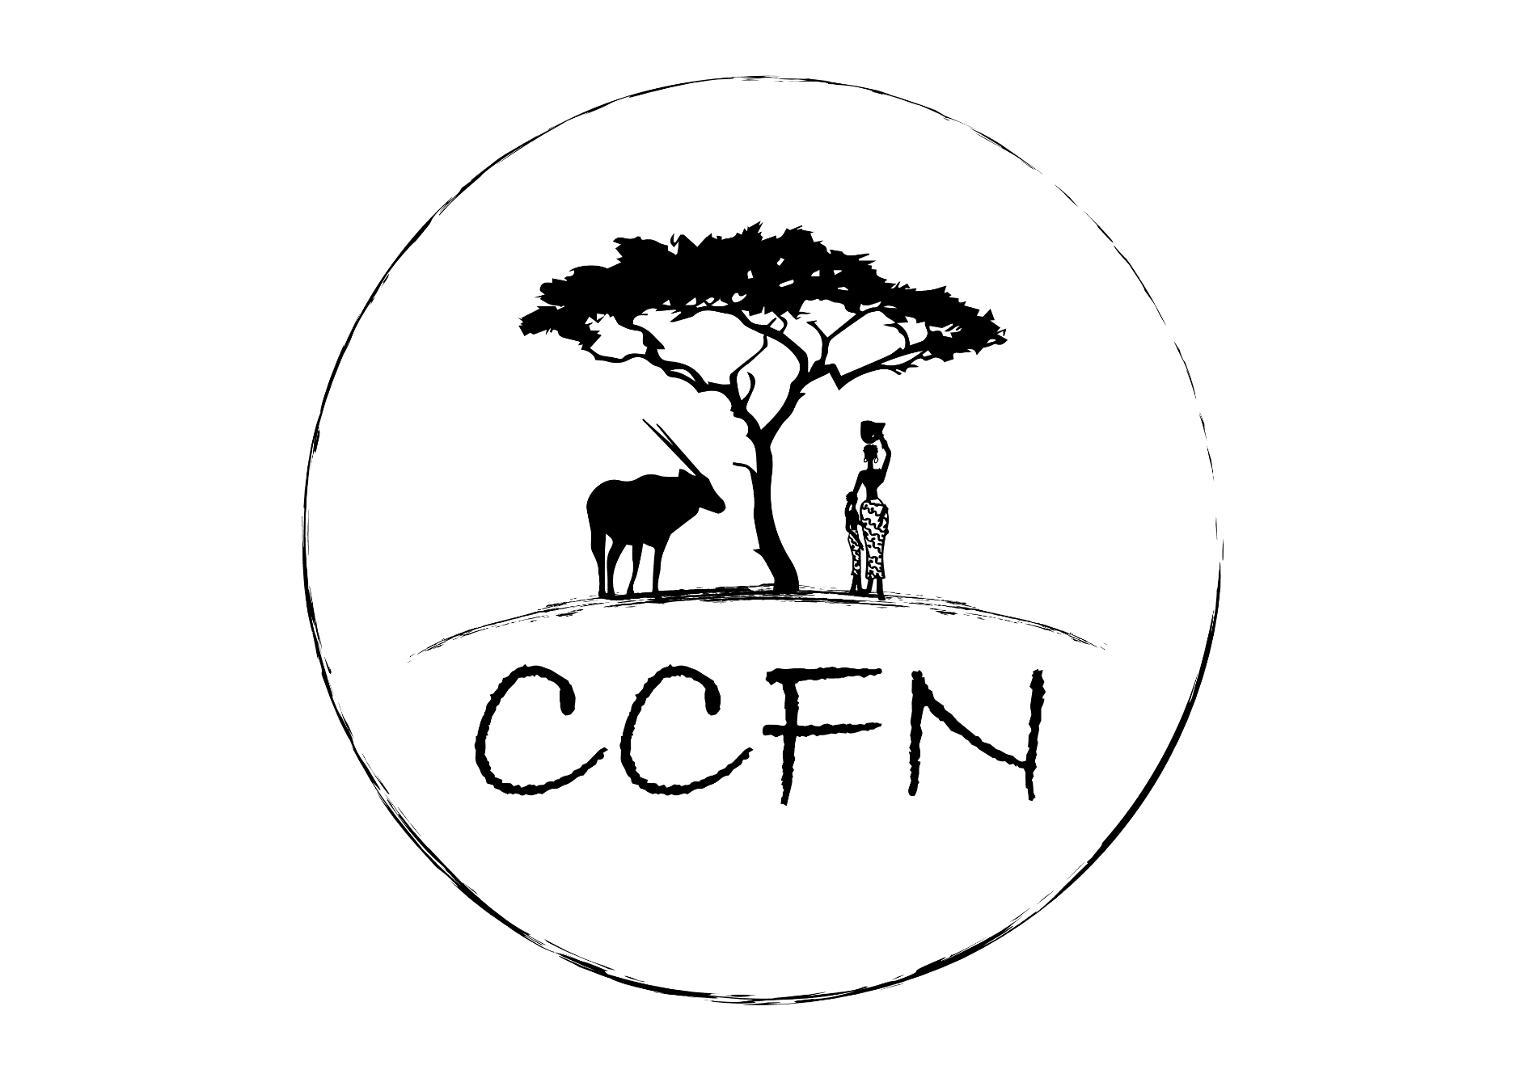

Mr. Tapiwa. A. M. Makiwa
Community Conservation Fund of Namibia (CCFN)- CEO
Consortium of African Funds for the Environment (CAFE) - VP
ceo@ccf-namibia.org
www.ccf-namibia.org

Slide 3
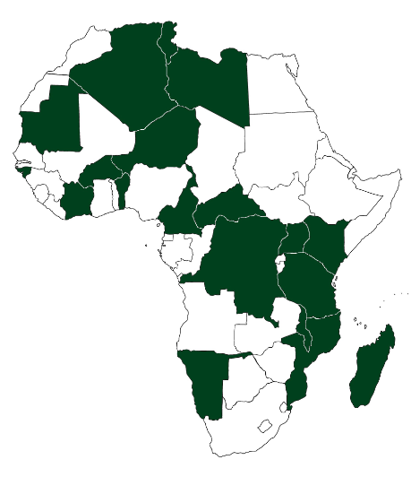


Slide 4
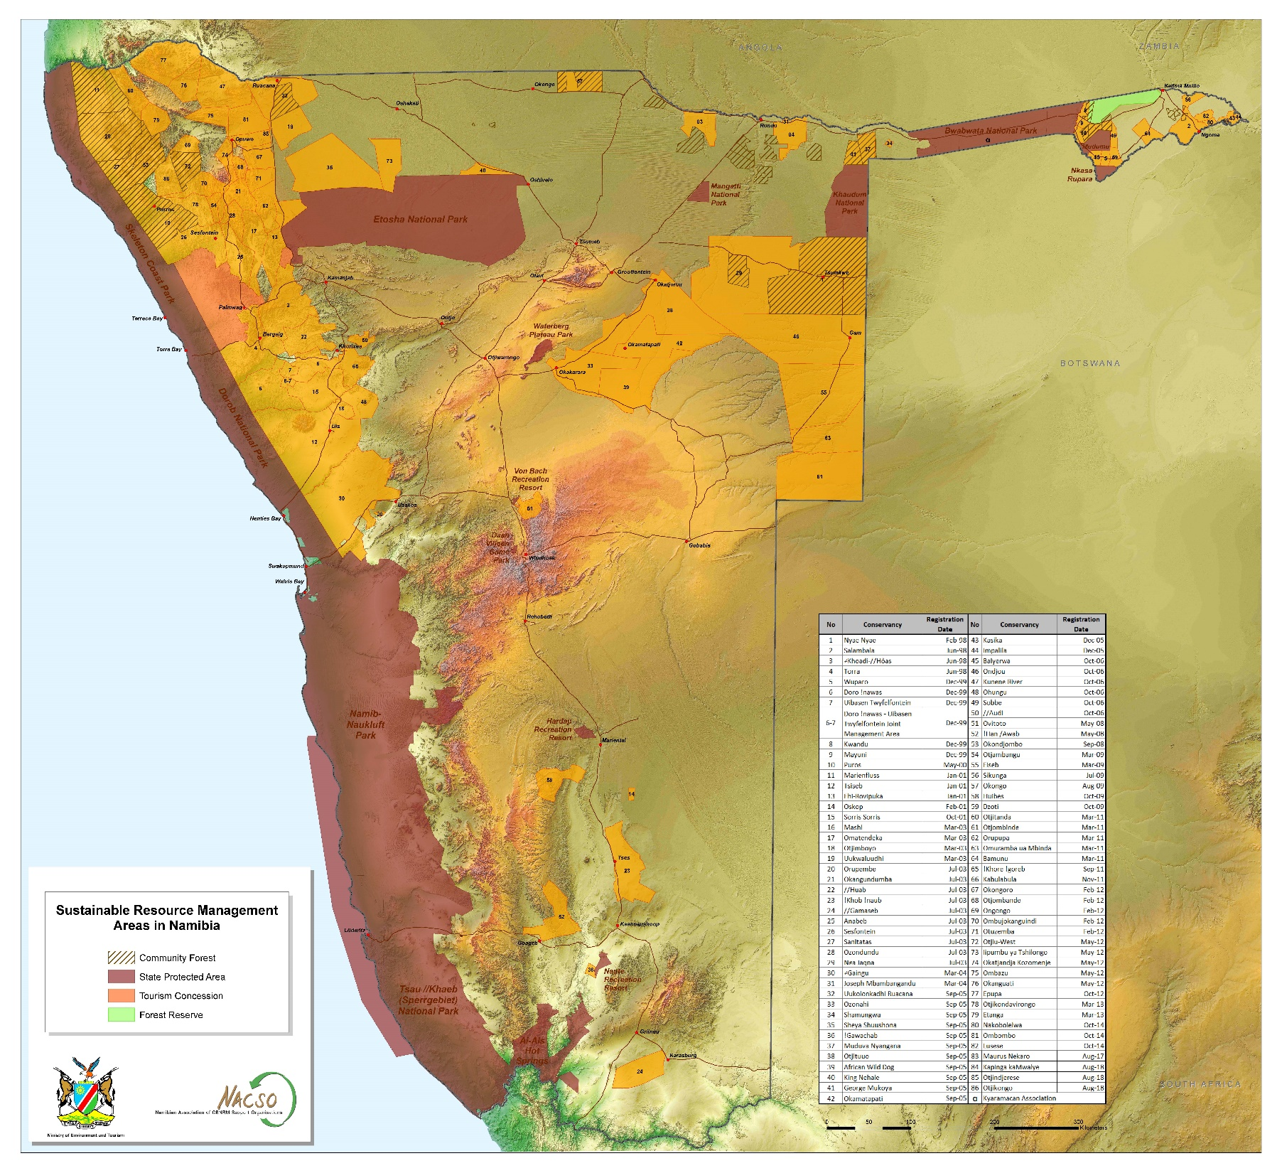
Total Conservation Statistics
+/-21% - National Parks
+/-21% - Community Based
+/- 42% total country
CBNRM – CCFN and other organizations
86 conservancies, 45 comm forests
About 220 000 residents
16mil ha of comm conservation land
“Contrasting beautiful Namibia”, varied eco-systems

Slide 5
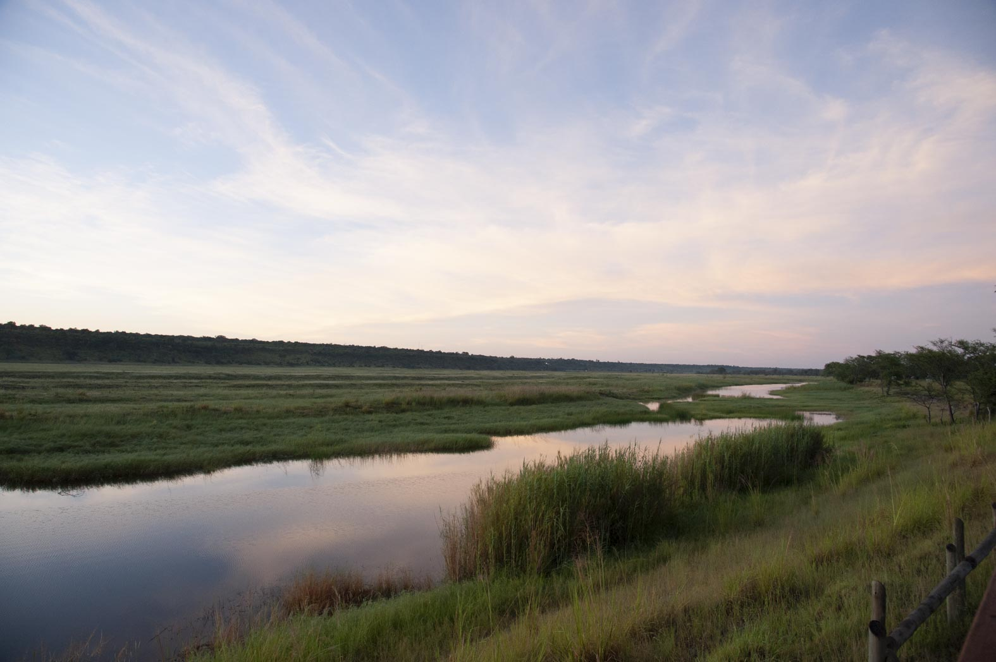
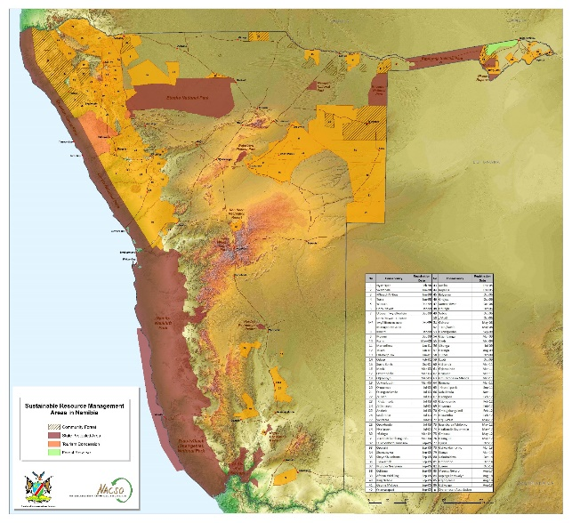

Slide 6
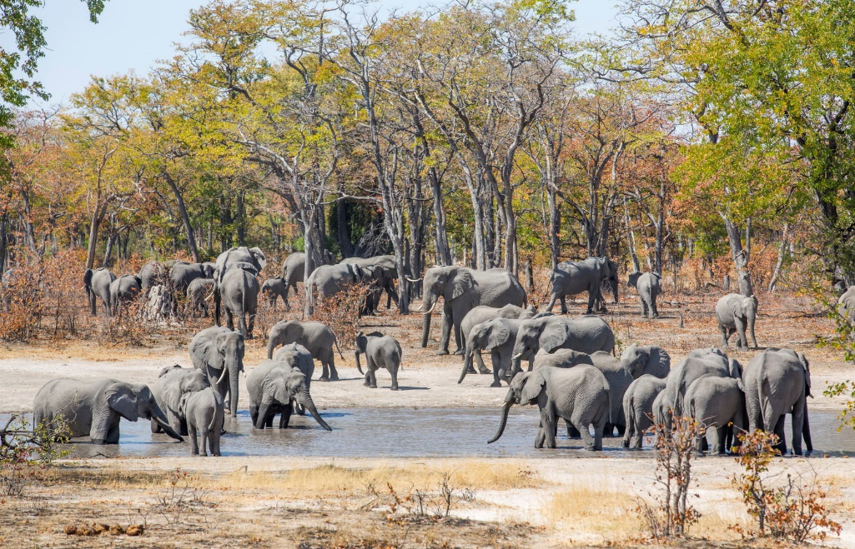


Slide 7
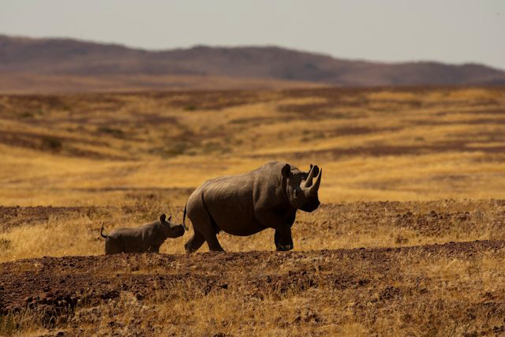
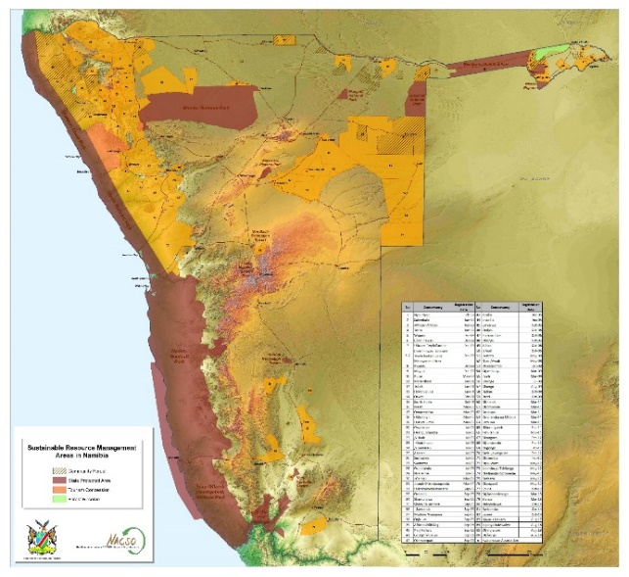

Slide 8
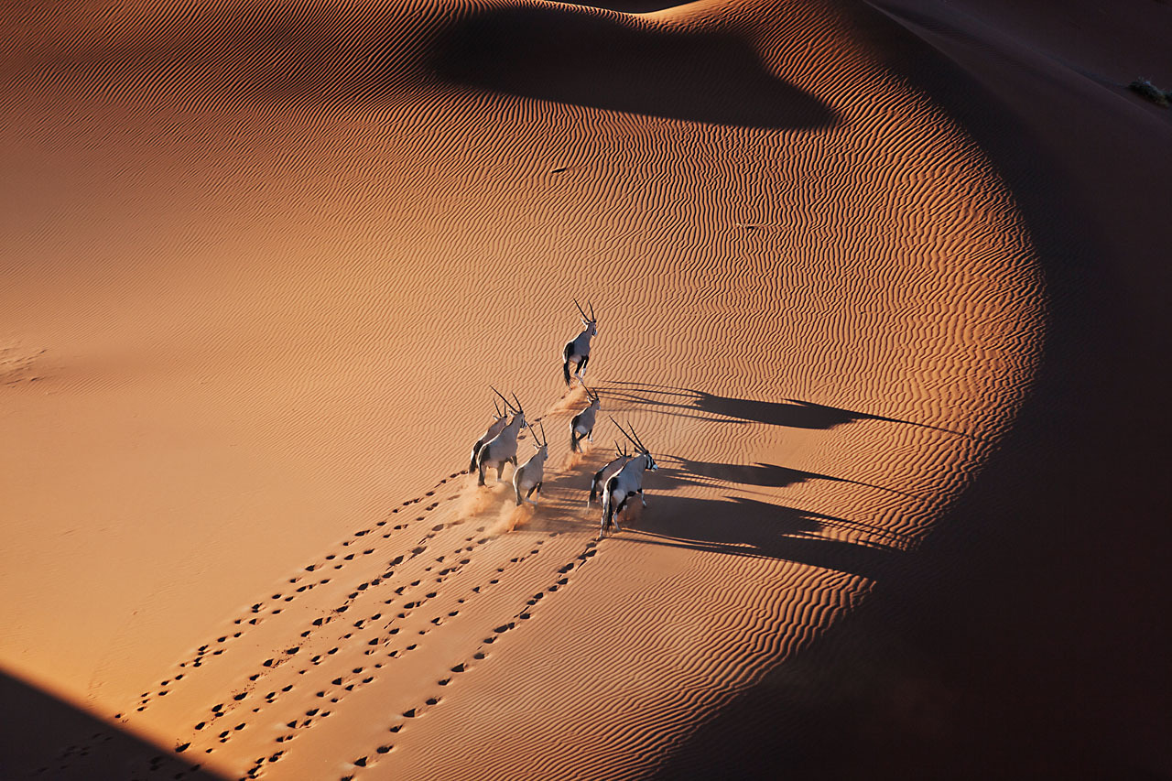

Slide 9
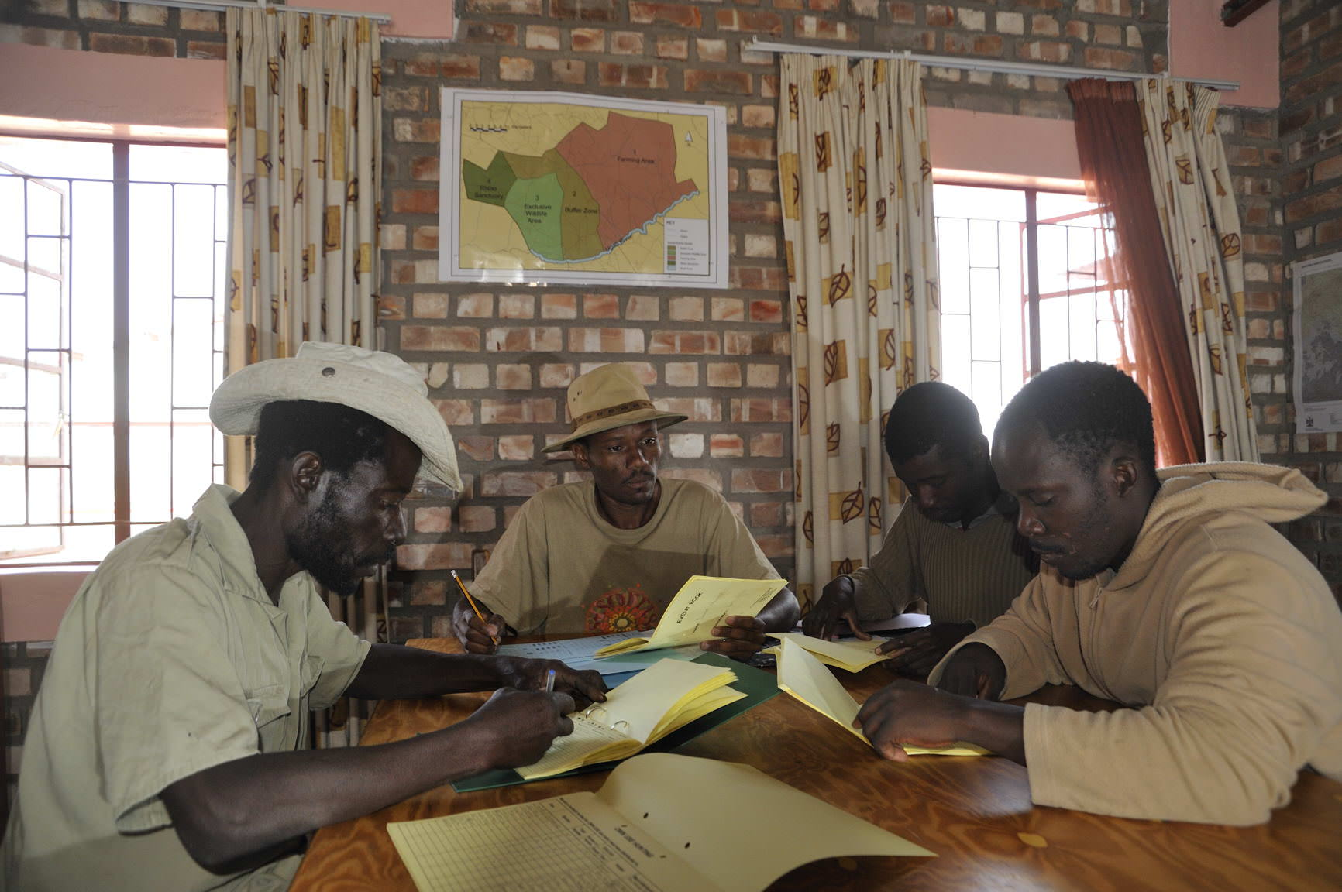

Slide 10
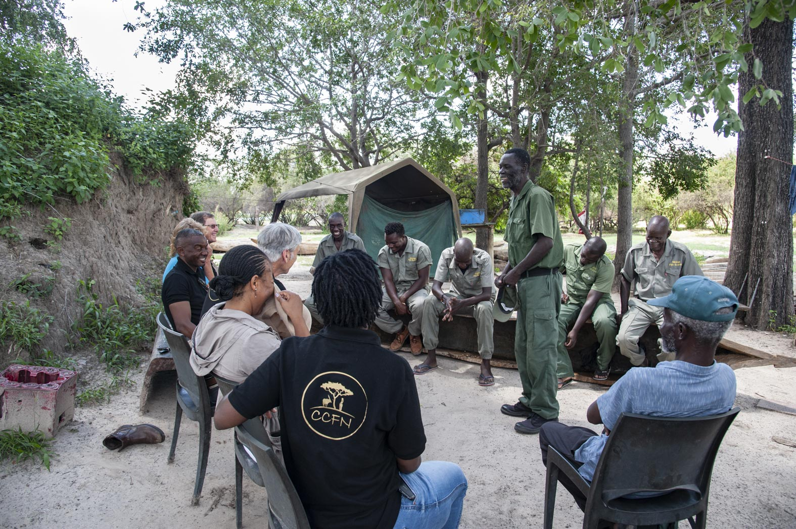

Slide 11
Problem : Inadequacies of current conservation financing models; climate change, not enough getting to the wildlife stewards,
Resulting in; diminishing biodiversity and increasing global economic and financial pressures.
A solution: Pay directly to the wildlife stewards for verifiable biodiversity results
Notes:
Why Wildlife Credits :
The Why: Wildlife Credits address the inadequate and, in some cases, flawed financing for wildlife and biodiversity conservation. For example, reinvestment from the wildlife tourism sector rests only on commercial operations on the ground, such as lodges. No platforms are available to tap into other parts of the value and supply chains that make up the multi-billion wildlife tourism sector. A second example is corporate financing (CSR) that, with a few exceptions, has been driven by discretionary payments for the desire to be seen as doing something good, yet is open to greenwashing, i.e. misleading claims made about their positive impact on the environment. A third example is the billions (US$) of conservation funds from private or public funding that primarily rely on conservation agents to carry out projects. Very little is based on paying directly to wildlife stewards for their conservation efforts and results. Instead, the majority is invested in projects “hoping” that the desired results will materialise while incurring considerable overheads. A fourth example is the dependence of wildlife stewards on income generated from wildlife use, i.e. tourism and hunting. COVID has demonstrated the vulnerability of this dependence. There is also the inevitable market failure in paying for public goods such as biodiversity. Hence even well-run farms often cannot cover the cost of rhino protection, or the alternative is overexploiting the resources one seeks to protect out of commercial requirement.
Problem:
Conservation of iconic wildlife, such as lions and elephants, comes at a considerable cost.
Current income streams, such as tourism and hunting, are insufficient and under threat.
While there is other significant conservation funding, the majority is for agents. Very little gets to the wildlife stewards.
Disproportional burden on wildlife stewards versus benefits generated by the value and supply chains within the wildlife economy
Resulting in
Despite Africa’s wildlife and wildlife habitat being a unique global asset that is also key to addressing net zero targets, it is increasingly under threat.
Solution
Conservation: Only pay once agreed-upon conservation results are achieved.
Livelihoods: Directly reduce the cost of living with wildlife and increase the benefits.
Resilience: Diversifies the income streams directly related to conservation efforts.
Efficiency: Reduced administrative overheads by directly paying “producers” on results.
Empowerment: Put the wildlife steward at the centre of decision making over conservation
Problem:
High administrative costs for managing the funds and projects.
Conservation funding is predominantly focused on paying for inputs and not results.
Wildlife income is vulnerable to excessive “use” and market forces.
Resulting in (examples)
…
…
A Solution :
Secure a public good, i.e. wildlife and habitat
Create a harmonious balance between conservation and development.
Empower the wildlife stewards
Challenges Living with wildlife comes with real challenges. Since the rural population in Namibia, where most wildlife resides, is generally poor and has few economic opportunities, finding land uses that do not threaten wildlife is also challenging. The irony is that conservation success, as measured by increased wildlife populations, leads to more human-wildlife conflict. When wildlife numbers increase, the population turns against them unless they see an increase in income. The costs of coexisting with wildlife are very real and include Opportunity cost of not being able to settle in the area and earn their traditional livelihood, Losses from wildlife, damage to crops and infrastructure, Protection of assets from wildlife (fences, staff), Emotional cost of living in fear of dangerous animals. These costs are exacerbated by climate change and increasing agriculture, which will put additional pressure on the environment and impoverished rural communities.

Slide 12
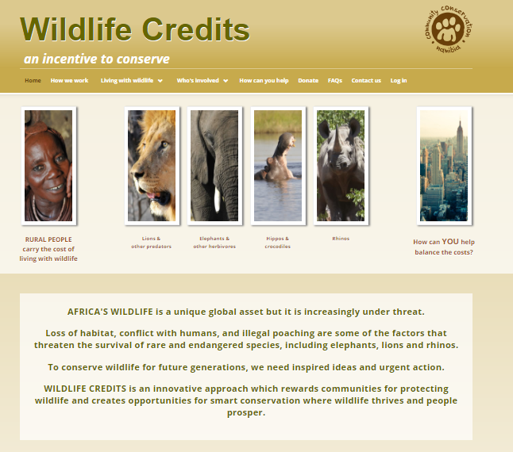
What is Wildlife Credits Namibia
Wildlife Credits pays wildlife stewards for protecting wildlife and wildlife habitats based on verifiable results.
It is a mechanism that recognizes wildlife stewards for protecting biodiversity, a global public good.
The payment is performance-based.
Notes:
SLIDE TWO : What is Wildlife Credits
Wildlife Credits pays wildlife stewards for protecting wildlife and wildlife habitats based on verifiable results.
It is a mechanism that recognises wildlife stewards for protecting biodiversity, a global public good.
The payment is performance-based.
Addresses
Conservation: Only pay once agreed-upon conservation results are achieved.
Livelihoods: Directly reduce the cost of living with wildlife and increase the benefits.
Resilience: Diversifies the income streams directly related to conservation efforts.
Efficiency: Reduced administrative overheads by directly paying “producers” on results.
Empowerment: Put the wildlife steward at the centre of decision making over conservation

Slide 13
PES “Wildlife Credits”
Species Performance:
i. Species Density/Index
ii. Calving / Breeding Nr.
iii. Species Presence
Habitat Integrity:
i. Wildlife Zones
ii. Wildlife Corridors
iii. Breeding habitats
Management Performance
i. Poaching Nr.
ii. Patrolling Effort
iii. Patrolling Sighting
Species Products
(Bio-diversity Richness)
Wildlife Landscape
(Base Payment)
Kunene Lions
(Lion Days)
Wildlife Sightings
Chobe Lions
Conservation Landscape
(Exclusive Wildlife Areas)
Wildlife Corridors
Kunene Elephants
Key species presence
Notes:
In Namibia, we are developing and piloting several Wildlife Credits product products being developed.
We started piloting with independently verifiable wildlife sightings and intact functioning wildlife corridors. Over the past 5 years we have on average paid out US$ 30,000 per annum and have secured US$ 500,000.
We are developing other Wildlife Credits products the the most significant being the Wildlife Landscapes which potentially could include secure 4 million hectares of conservation areas that conservancies have zoned for no settlement and no cropping. Other products are more species focus and include wildlife sightings of iconic species that come at a cost to the rural communities, i.e. lions, elephants and rhinos.
Our target is to create US$ 2 million per annum from the wildlife credits products, which is similar to what conservancies generate in fees from hunting and tourism concessions.
To design the product we have developed a template that asks critical questions that are essential to get clarity on if the products are appropriate for the wildlife stewards and appropriate the “payers”.

Slide 14
Wildlife Credits: Illustration of
Pricing Mechanism for Wildlife Areas and Related Species Products
Base Payment
1. Calcuation of the the size of wildlife area in Ha
Bonus Payment
2. Proxy Value / Ha
3. Biodiversity Richness
4. Key species presence
2.1. Animal production
Potential (livestock/wildlife)
3.1. Biodiversity Index
4.1 IUCN Threatened Species
It is calculated using the Carrying Capacity Category (animal biomass per ha) x the average price of meat.
The actual production of animals (live mass) is derived and followed by a correction for the dressed weight.
It is calculated using the Plant Endemism & Diversity ranking as a total biodiversity score.
This allows to get a % metric which tells as how much of the maximum ranking level is identified in this area. Based on this, the Biodiversity Index corrects the proxy value with a factor of 1.25, 1 or 0.75
It is calculated using the IUCN Threatened Species list x 2% per species on Base Payment.
To determine the species present, the conservancy uses camera traps and SMART app to record and provide evidence of presence.
Note: Proxy value is a value that is not directly relevant, but that serves in place of an unobservable or immeasurable value. For it to be a good proxy value, it must have a close correlation with the product of interest
Notes:
Pricing Mechanism:
The design of the pricing mechanism is as important as the product’s design. Getting this wrong will either have unintended consequences on the ground, or the market will not be interested. For the Wildlife Landscapes we have developed a pricing mechanism that considers the integrity of any area, the biodiversity richness of the area, and the presence of key species (which we have opted for species from the IUCN threatened species).
The Wildlife Areas’ hectarage forms the Base Payments by providing a basis for the monetary value: This is calculated using the Carrying Capacity Category (animal biomass per ha) x the average price of meat. The actual production of animals (live mass) is derived and followed by a correction for the dressed weight. The base payment is admittedly a proxy value. So while not directly relevant to the product, it does provide logic for pricing a value for an immeasurable value. And because of the close correlation with the product of interest, we believe it will be acceptable to both the wildlife stewards and the “payers”.
Determining the biodiversity richness provides a correction factor to the base value depending on how important the area is for biodiversity conservation. And the key species presence provides a further incentive for conservancies to protect and further interest in the markets to pay.
We have taken a similar approach in pricing important wildlife corridors.

Slide 15
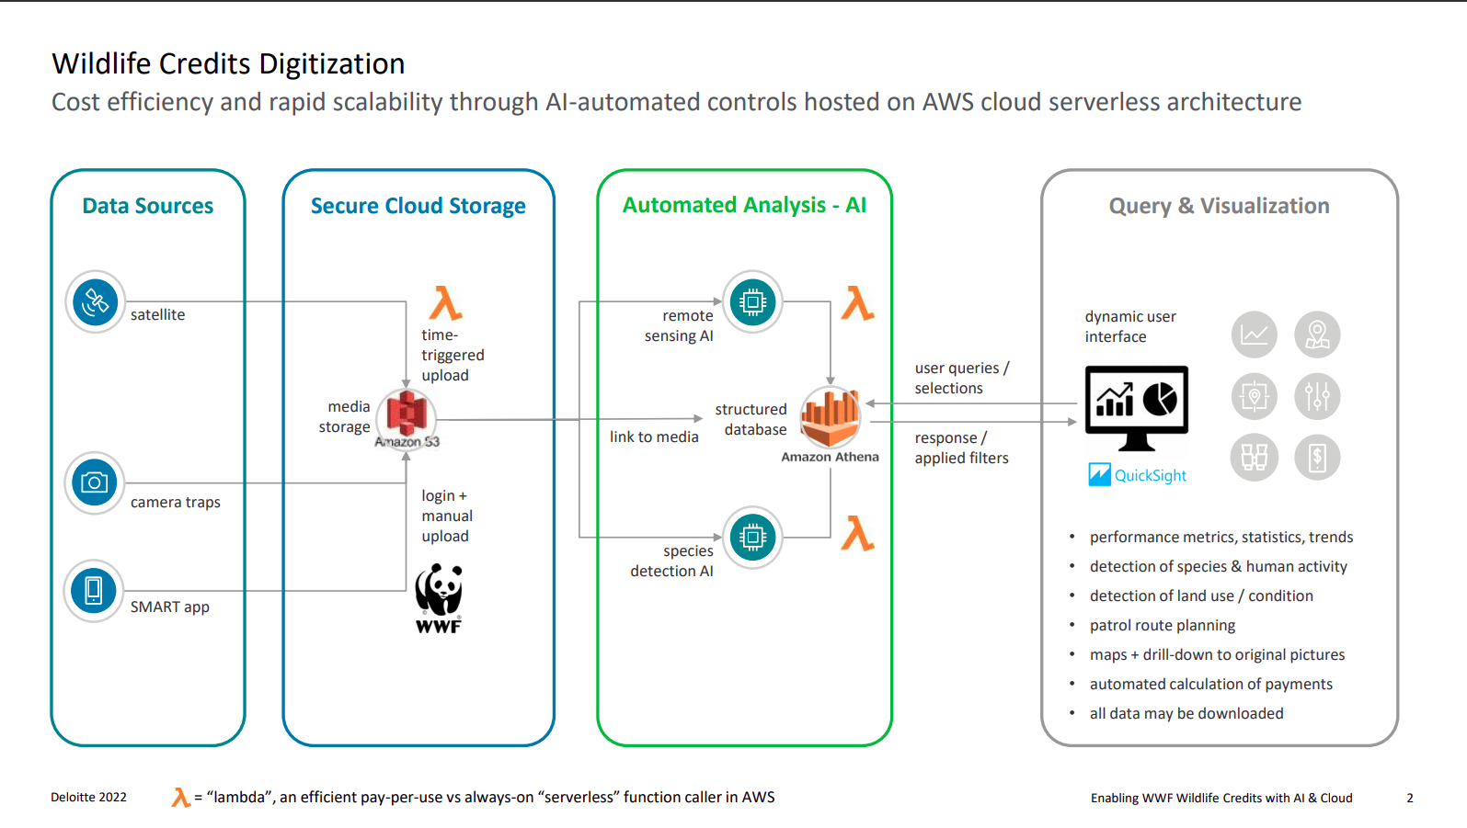

Slide 16
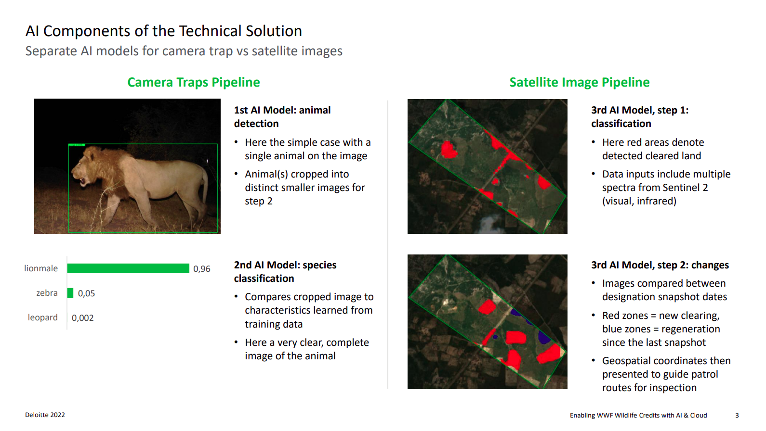

Slide 17
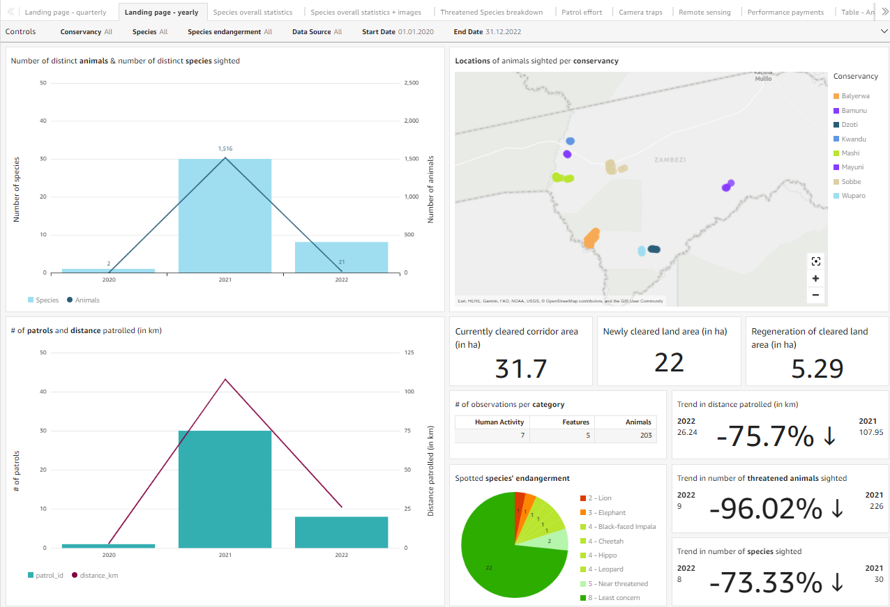

Slide 18
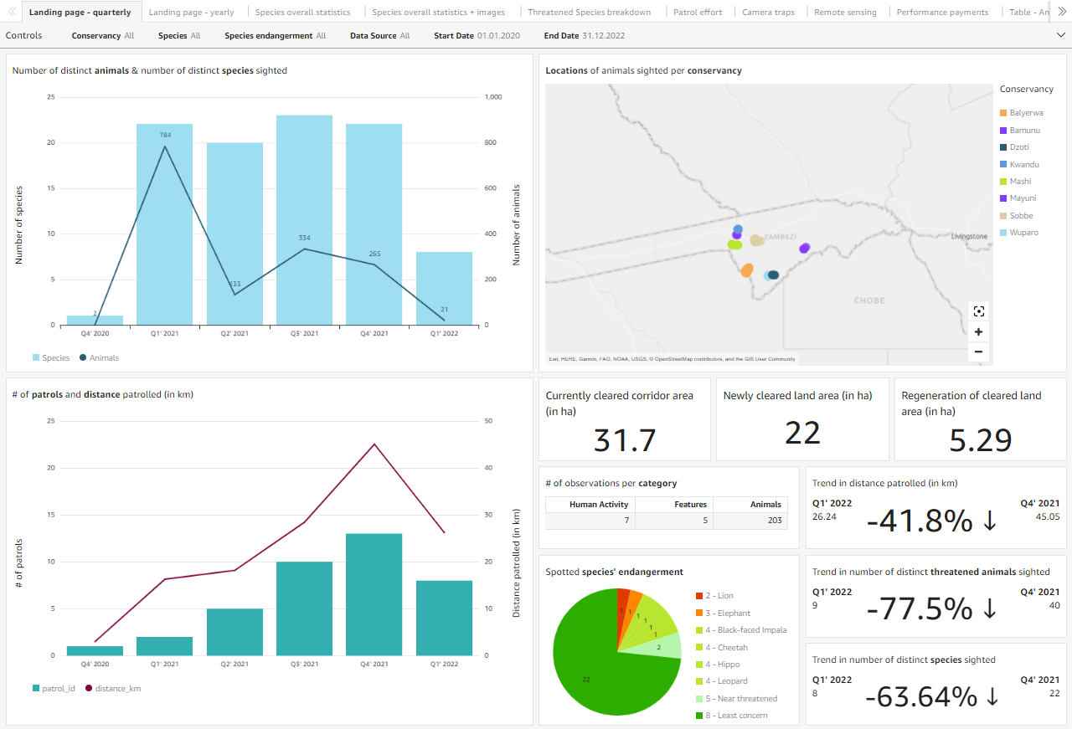

Slide 19
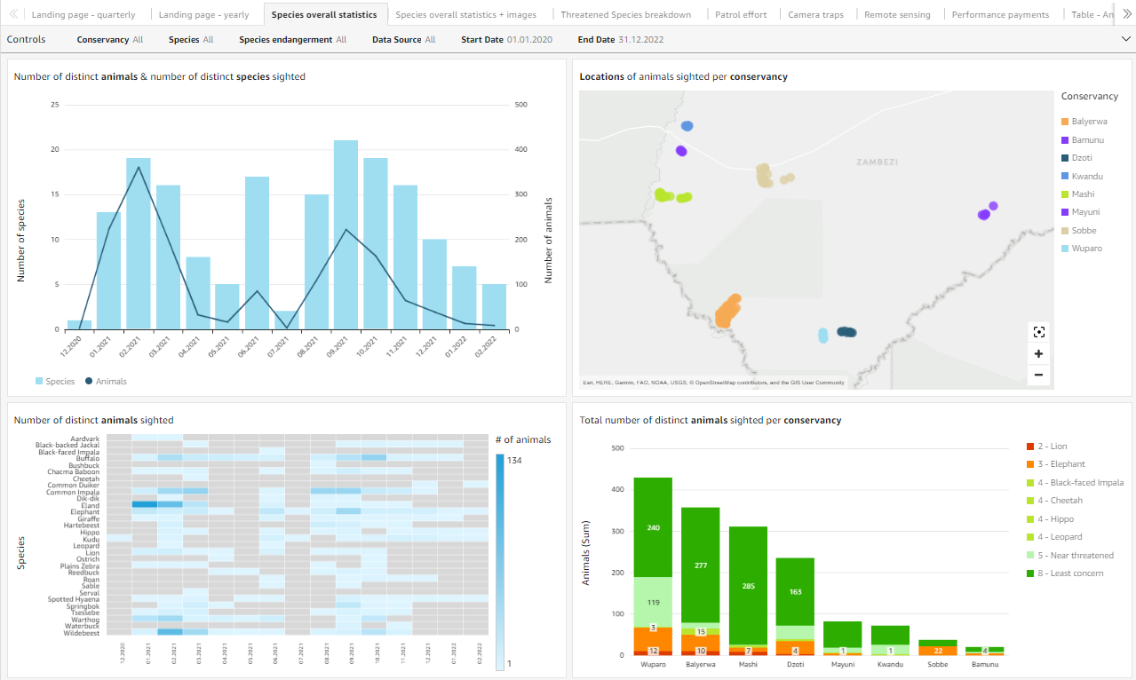

Slide 20
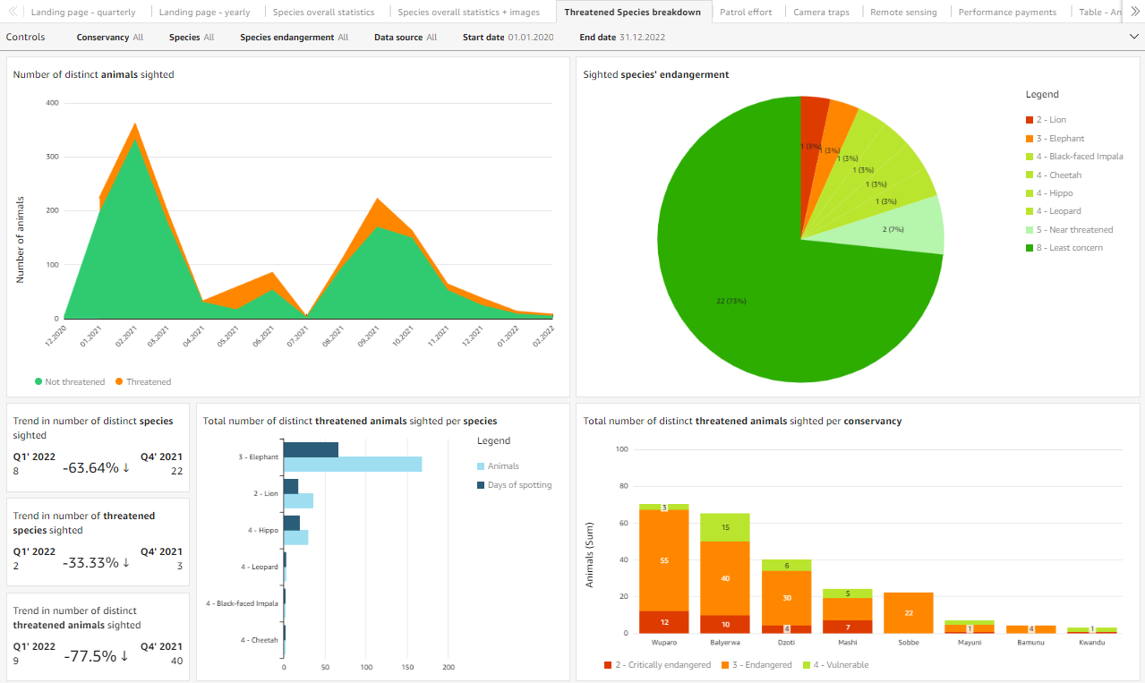

Slide 21
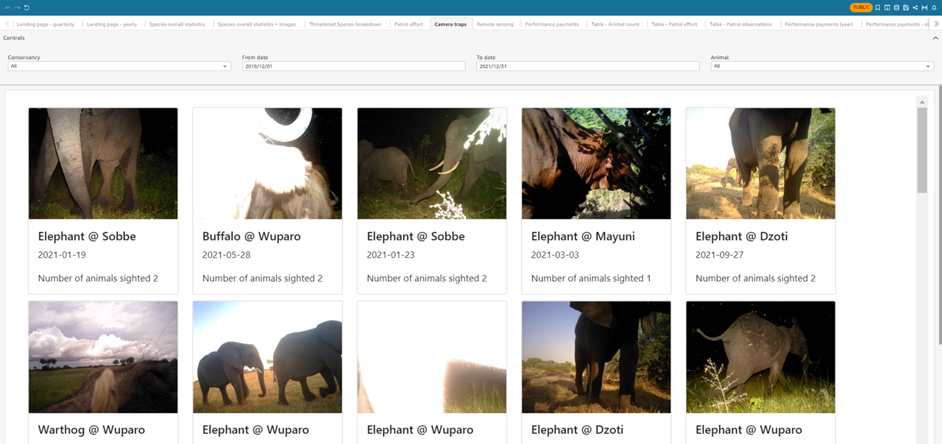

Slide 22
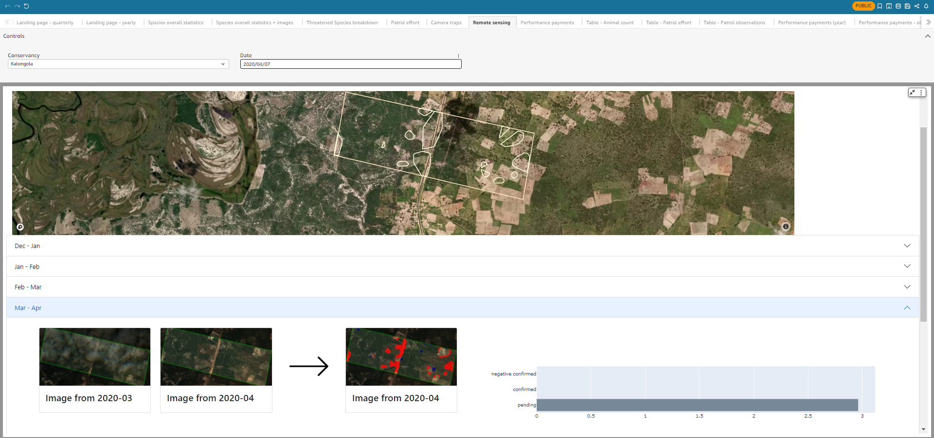

Slide 23
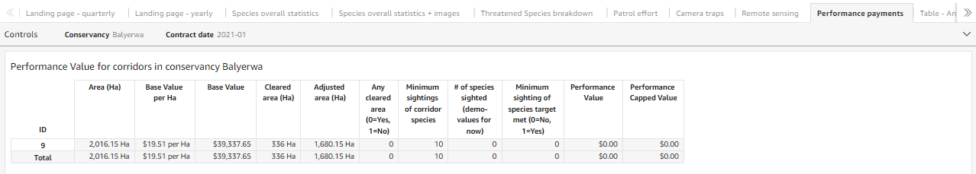
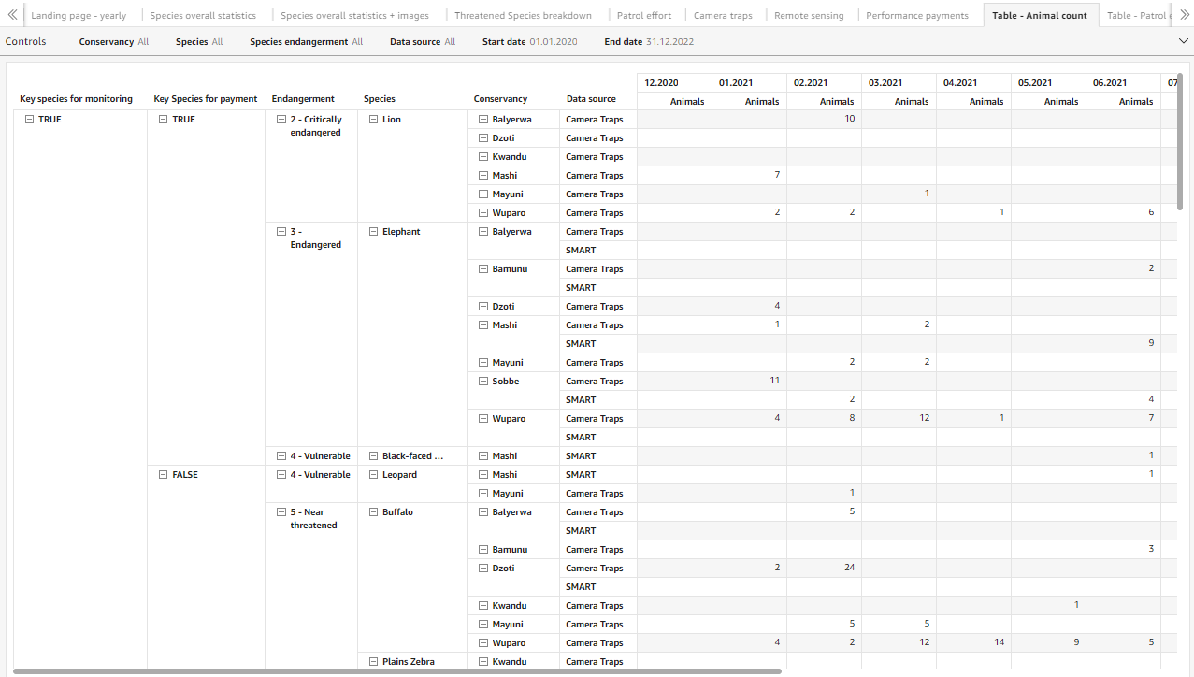
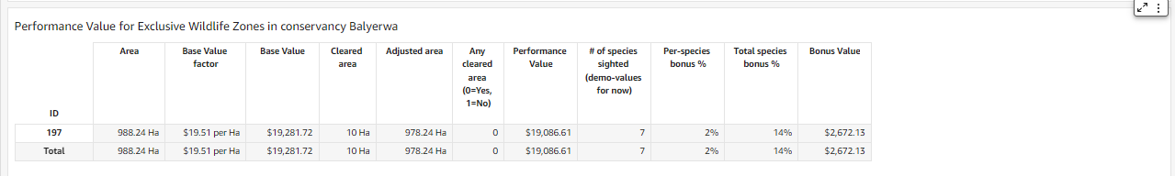
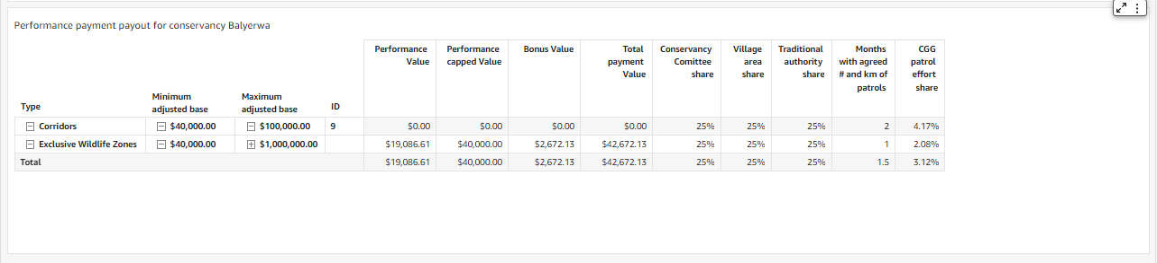

Slide 24
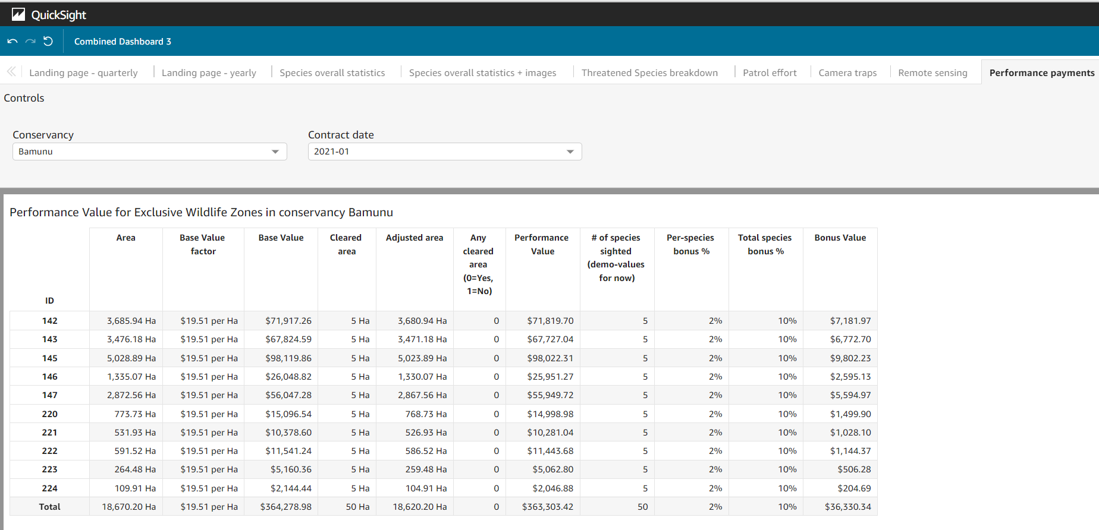

Slide 25
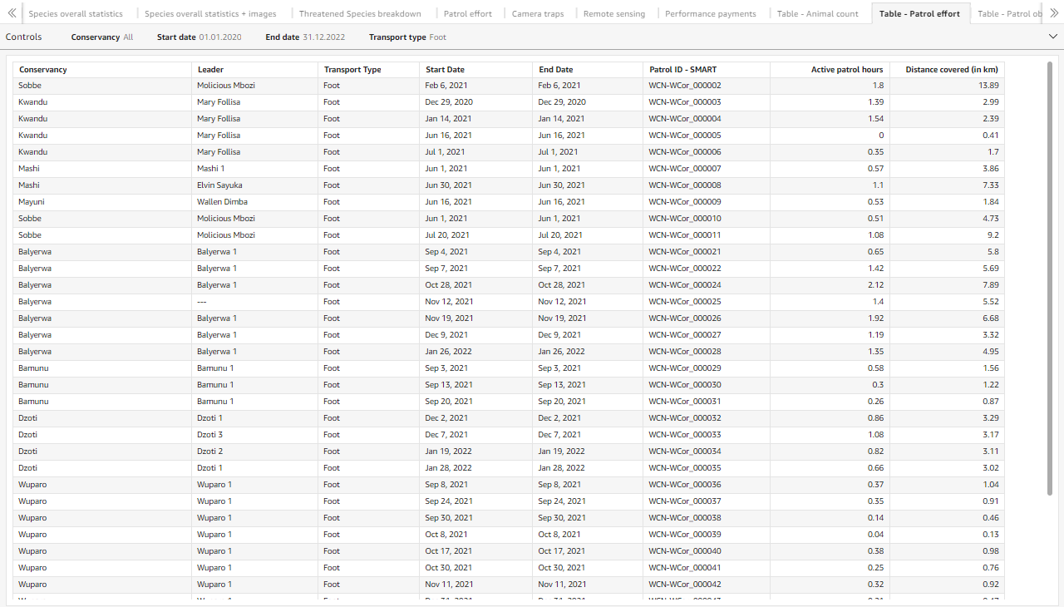
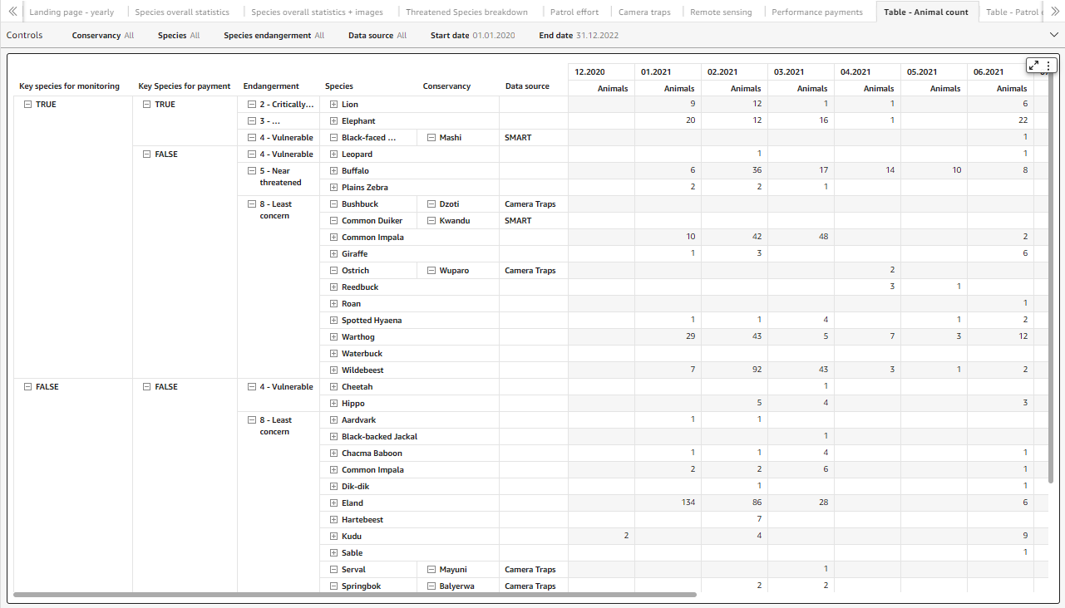

Slide 26
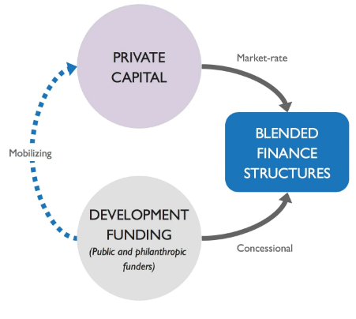
Wildlife Credits: Wild Landscape
Business Model – Blended Approach
Notes:
Business model in financing Wildlife Credits
We taking a Blended financing approach which is the strategic use of philanthropic development funding to mobilise public finance to apportion level commitments and increase financial sustainability.
The primary market secures grants that is invested in the national wildlife credits fund housed at CCFN. This fund guarantees performance payments based on the contractual arrangement, de-risking the wildlife stewards’ exposure to nature-based market forces.
Once the evidence of performance is received and payment is made, the national fund has created a “credit” that can then be traded on a secondary market platform. When sold, the payments are re-invested into the national fund.

Slide 27
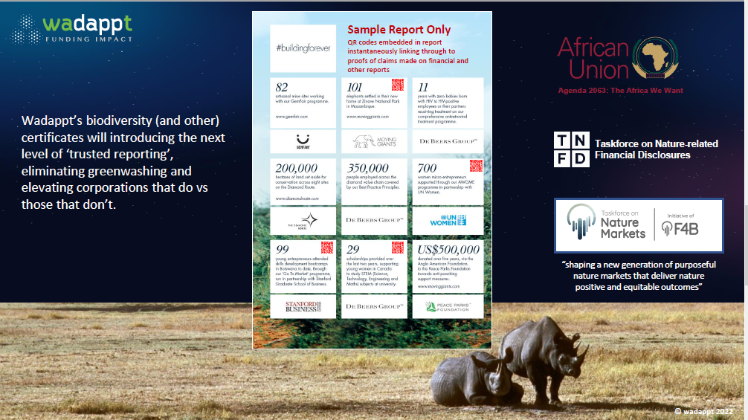
Notes:
Biodiversity markets
The world has recognised that if we are going to address the threats from climate change, then we will have to address the threats from biodiversity loss. It is no longer a question of whether there will be a global market for biodiversity but of when and how.

Slide 28
QUESTIONS
Mr. Tapiwa. A. M. Makiwa
Community Conservation Fund of Namibia (CCFN)- CEO
ceo@ccf-namibia.org
www.ccf-namibia.org

